Slide 1
New media and humanitarian aid
Daniel Stauffacher
Chairman, ICT4Peace Foundation

Slide 2
Mobiles, the web and the Internet have changed the face of humanitarian aid
It’s still dirty, hard work on the ground, but decisions are increasingly made on the basis of information coming from a range of new sources, including directly from victims and beneficiaries.
Can these sources be trusted? How can information be verified, disseminated and shared?
What is the Foundation doing?

Slide 3
“My name is Mohammed Sokor, writing to you from Dagahaley refugee camp in Dadaab. Dear Sir, there is an alarming issue here. People are given too few kilogrammes of food. You must help.”
SMS is already changing the way aid logistics are designed and implemented.
It may never happen, but it would be interesting to measure the impact on donor support if alongside regular food rations, WFP could hand out mobile phones and a list of telephone number of agency heads.

Slide 4
Google Earth on Darfur

Slide 5
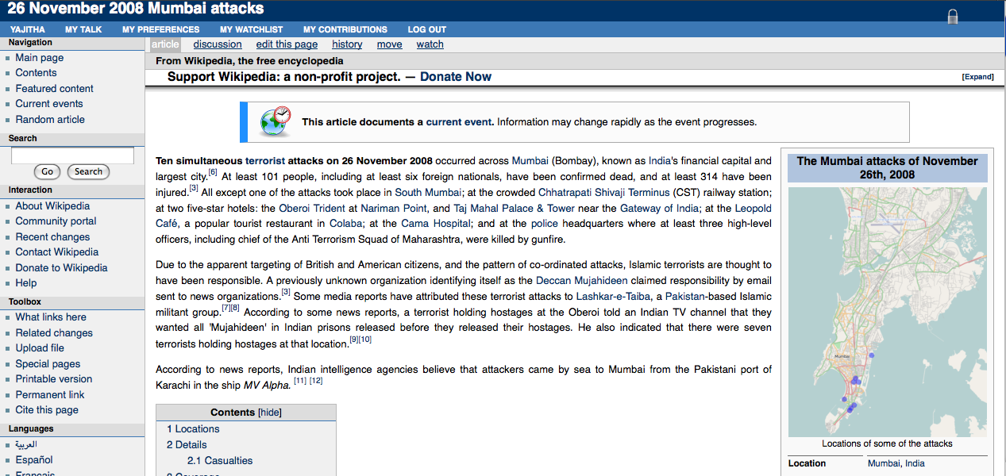
Wikipedia http://en.wikipedia.org/wiki/26_November_2008_Mumbai_attacks

Slide 6
Wikipedia http://en.wikipedia.org/wiki/26_November_2008_Mumbai_attacks
400+ edits / updates
100+ authors
All less than 24 hours after first attack

Slide 7
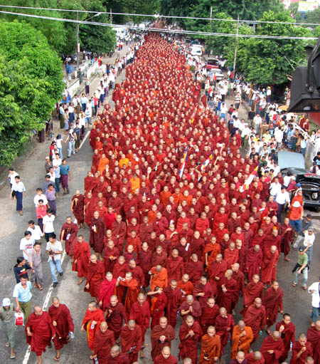
Myanmar’s Saffron Revolution in 2007
100,000 people joined a Facebook group supporting the monks
No international TV crews allowed in the country
Mobile phone cameras were the first footage of the monks protest
Blogs from Rangoon were the only sources of information
The junta shut down all Internet and mobile communications

Slide 9
Citizen journalism / New Media
Traditional media
Trusted intelligence / UN
Situational awareness

Slide 11
ICT4Peace Crisis Information Management Demonstrator http://cimd.ict4peace.org/

Slide 12
ICT4Peace CIMD designed to qualify crowd sourced information to aid critical decision making
Can be accessed over the web and mobile phones
Can plug into other systems
Gets information from Twitter, RSS feeds, SMS, email and web form
Information qualification built in to backend – to ensure only accurate information feeds decision making

Slide 13
Questions to ponder
Twitter on Iran a key source of information, but how representative was it? Did it capture rural opinion?
Twitter empowers citizens to report in real time, but how accurate are these reports? Are instant experts trustworthy? Are eye witness reports always right?
How can information be shared at a time of crisis amongst key international and domestic actors? Is interoperability vital to saving lives?
What mechanisms can help verify crowd-sourced information?

Slide 14
Challenges to meet
Policy makers need to embrace, not resist, new media
Interoperability is fundamentally important
Better information and knowledge management vital to crisis prevention, mitigation and recovery
Buy in from senior management in institutions vital to success of crisis information management mechanisms
Need to treat beneficiaries as partners, not just as recipients

Slide 15
Thank you! danielstauffacher@ict4peace.org http://www.ict4peace.org

