Slide 1
2012 Conference on Health and Humanitarian Logistics March 21-23 · Hamburg, Germany Daniel Stauffacher, Chairman, ICT4Peace Foundation www.ict4peace.org

Slide 2
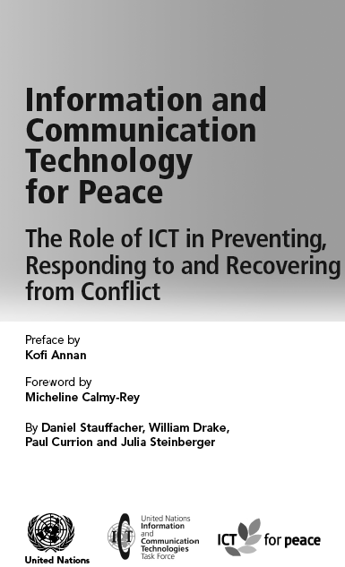
The unique and crucial Role of ICTs in Preventing, Responding to and Recovering from Conflict or any humanitarian disaster (WSIS Tunis, UN ICT Task Force, 2005)

Slide 3
The ICT4Peace Foundation
The ICT4Peace Foundation aims to enhance the performance of the International community in crisis management through the use of ICTs that facilitates improved, effective and sustained communication between peoples, communities and stakeholders involved in conflict prevention, mediation and peace building through better understanding of and enhanced application of Information Communications Technology (ICT) including Media and Social Media.
ICT4Peace aims to facilitate a holistic, cohesive and collaborative mechanisms directly in line with Paragraph 36 of the World Summit on the Information Society (WSIS) Tunis Declaration (2005):
“36. We value the potential of ICTs to promote peace and to prevent conflict which, inter alia, negatively affects achieving development goals. ICTs can be used for identifying conflict situations through early-warning systems preventing conflicts, promoting their peaceful resolution, supporting humanitarian action, including protection of civilians in armed conflicts, facilitating peacekeeping missions, and assisting post conflict peace-building and reconstruction.”between peoples, communities and stakeholders involved in crisis management, humanitarian aid and peacebuilding.

Slide 4
Report of the UN Secretary-General A/65/491) Status of implementation of the information and communications technology strategy for the United Nations Secretariat.
Crisis information management strategy. The Crisis Information Management Strategy is based on the recognition that the United Nations, its Member States, constituent agencies and non-governmental organizations need to improve such information management capacity in the identification, prevention, mitigation, response and recovery of all types of crises, natural as well as man- made. The strategy will leverage and enhance this capacity and provide mechanisms to integrate and share information across the United Nations system.
The Office of Information and Communications Technology (CITO), together with the Office for the Coordination of Humanitarian Affairs (OCHA), the Department of Peacekeeping Operations and the Department of Field Suppor (DPKO and DFS), has worked closely with United Nations organizations such as the Office of the United Nations High Commissioner for Refugees (UNHCR), the United Nations Children’s Fund (UNICEF), the United Nations Development Programme (UNDP) and WFP and other entities such as the ICT for Peace Foundation in developing and implementing this strategy. It is envisaged that membership will be expanded to include other United Nations organizations in the near future.

Slide 5
bearing witness and communicating Barriers to and financial costs have fallen drastically
Event / Issue
a priori
a posteriori
Victims
Witnesses
Citizen media
UN system
Mainstream
media
International
Community
Government

Slide 6
New ICTs for shared situational awareness
Twitter (micro-blogging)
RSS (e.g. Google News Reader)
Mobiles (SMS)
GPS (real time location data)
Crowdsourcing (Ushahidi)
Crisis Mapping (GIS – Google Maps / Google Earth, Crisis Mappers)
VoIP (e.g. Skype)
Social networking (e.g. Facebook)
Notes:
These are just examples of some ICTs that can be used to get situational awareness from the field and also disseminate vital information in a timely manner to concerned actors.

Slide 7
Information breakdown in crisis situation
New media
Twitter
Flickr
Mainstream media
CNN / BBC / Al Jazeera
Local / National TV and radio
Sit reps
Humanitarian Information Centres
Blogs
SMS / MMS / Mobiles
Print media (mainstream / regional)
Agency databases / email lists
Personal contacts / relationships
Social networks
Alternative print media
Open Data Open Gov Data
Traditional Sources

Slide 8
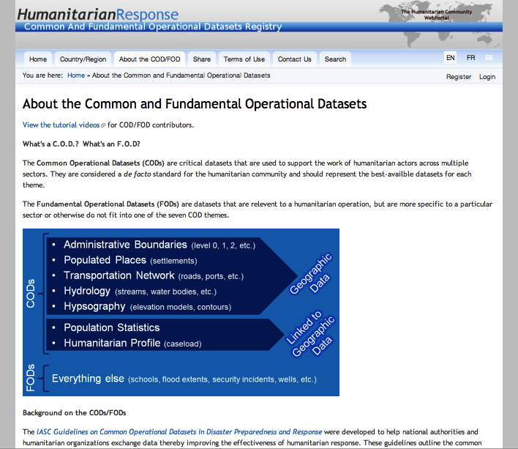
The ICT4Peace Foundation
The ICT4Peace Foundation aims to enhance the performance of the International community in crisis management through the use of ICTs that facilitates improved, effective and sustained communication between peoples, communities and stakeholders involved in conflict prevention, mediation and peace building through better understanding of and enhanced application of Information Communications Technology (ICT) including Media and Social Media.
ICT4Peace aims to facilitate a holistic, cohesive and collaborative mechanisms directly in line with Paragraph 36 of the World Summit on the Information Society (WSIS) Tunis Declaration (2005):
“36. We value the potential of ICTs to promote peace and to prevent conflict which, inter alia, negatively affects achieving development goals. ICTs can be used for identifying conflict situations through early-warning systems preventing conflicts, promoting their peaceful resolution, supporting humanitarian action, including protection of civilians in armed conflicts, facilitating peacekeeping missions, and assisting post conflict peace-building and reconstruction.”between peoples, communities and stakeholders involved in crisis management, humanitarian aid and peacebuilding.

Slide 9
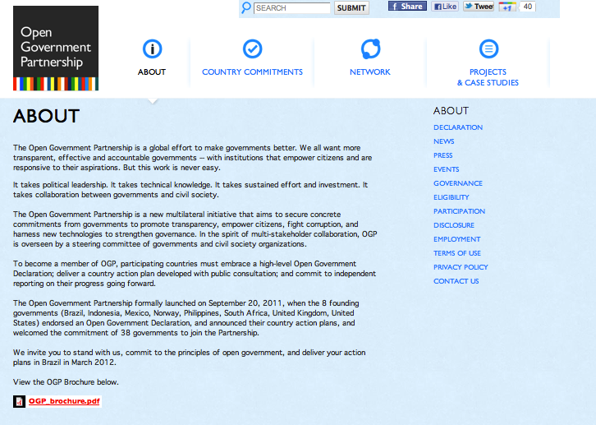
The ICT4Peace Foundation

Slide 11
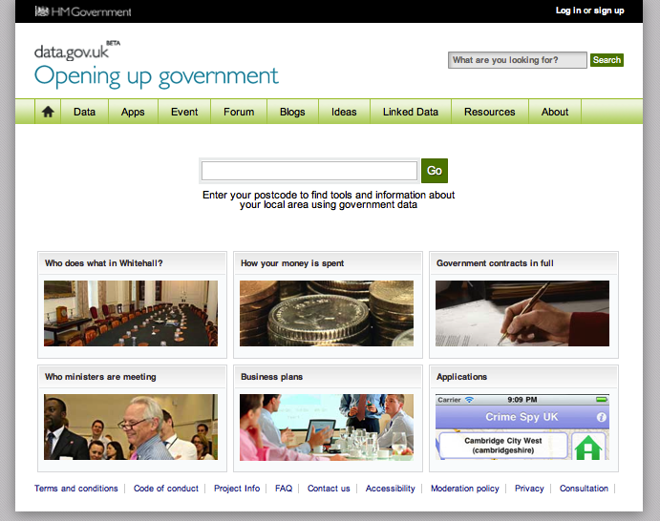
The ICT4Peace Foundation
The ICT4Peace Foundation aims to enhance the performance of the International community in crisis management through the use of ICTs that facilitates improved, effective and sustained communication between peoples, communities and stakeholders involved in conflict prevention, mediation and peace building through better understanding of and enhanced application of Information Communications Technology (ICT) including Media and Social Media.
ICT4Peace aims to facilitate a holistic, cohesive and collaborative mechanisms directly in line with Paragraph 36 of the World Summit on the Information Society (WSIS) Tunis Declaration (2005):
“36. We value the potential of ICTs to promote peace and to prevent conflict which, inter alia, negatively affects achieving development goals. ICTs can be used for identifying conflict situations through early-warning systems preventing conflicts, promoting their peaceful resolution, supporting humanitarian action, including protection of civilians in armed conflicts, facilitating peacekeeping missions, and assisting post conflict peace-building and reconstruction.”between peoples, communities and stakeholders involved in crisis management, humanitarian aid and peacebuilding.

Slide 12
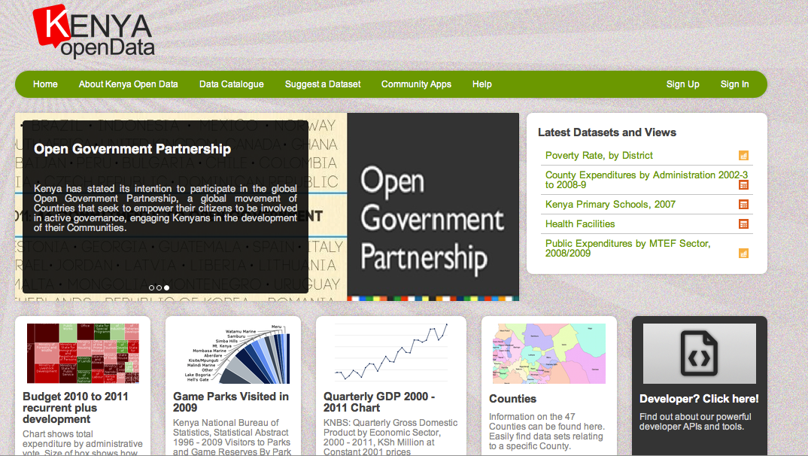
The ICT4Peace Foundation
The ICT4Peace Foundation aims to enhance the performance of the International community in crisis management through the use of ICTs that facilitates improved, effective and sustained communication between peoples, communities and stakeholders involved in conflict prevention, mediation and peace building through better understanding of and enhanced application of Information Communications Technology (ICT) including Media and Social Media.
ICT4Peace aims to facilitate a holistic, cohesive and collaborative mechanisms directly in line with Paragraph 36 of the World Summit on the Information Society (WSIS) Tunis Declaration (2005):
“36. We value the potential of ICTs to promote peace and to prevent conflict which, inter alia, negatively affects achieving development goals. ICTs can be used for identifying conflict situations through early-warning systems preventing conflicts, promoting their peaceful resolution, supporting humanitarian action, including protection of civilians in armed conflicts, facilitating peacekeeping missions, and assisting post conflict peace-building and reconstruction.”between peoples, communities and stakeholders involved in crisis management, humanitarian aid and peacebuilding.

Slide 13
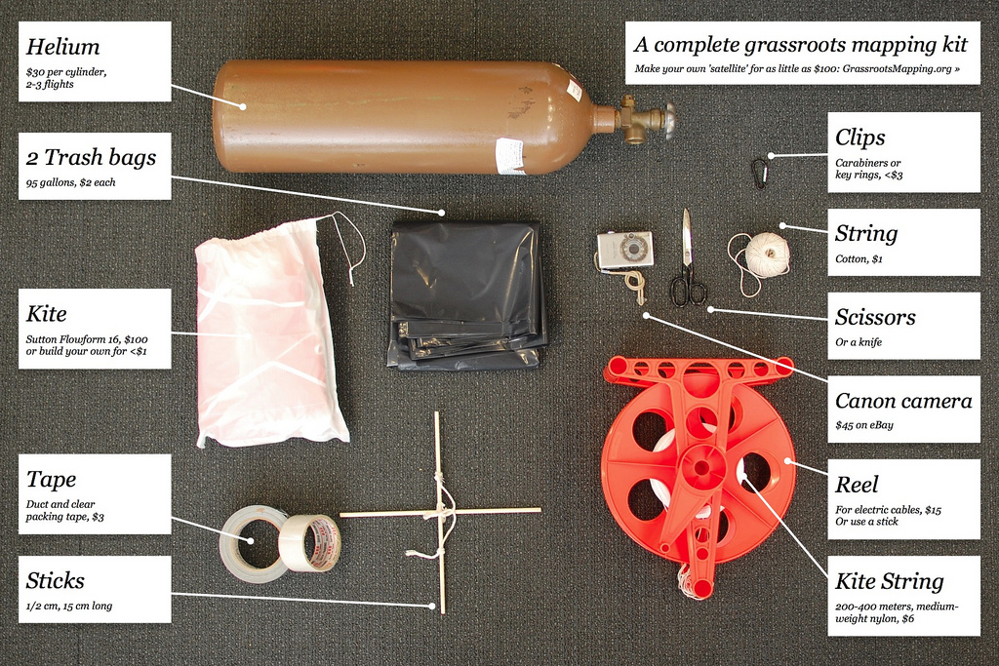
crowd sourcing mapping | new maps http://publiclaboratory.org/sites/default/files/4445981062_73945db207_b_2.jpg
Notes:
In addition to UNOSAT, UNITAR etc. and other actors from the UN system, there is now a burgeoning community focussed, community driven, volunteer led mapping movement around the world.
Today, for under $200, you can get better resolution local imagery than can be commercially bought for tens of thousands of dollars.
Plenty of examples to be found - this is the democratisation of mapping tools, GIS and analysis. See some examples.
Old mapping tools and analysis are more likely to be closed - closed information loops, closed groups analysing this information, information not widely disseminated.
New paradigm is open - from sources to analysis, but bounded information gathering and analysis also possible in this model.

Slide 14
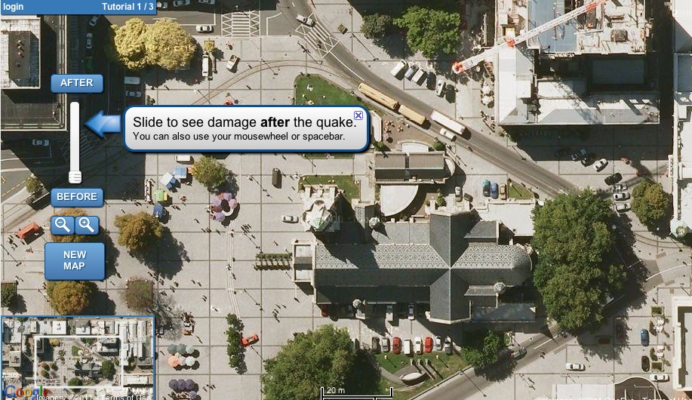
Christchurch: damage assessment http://tomnod.com/geocan/

Slide 15
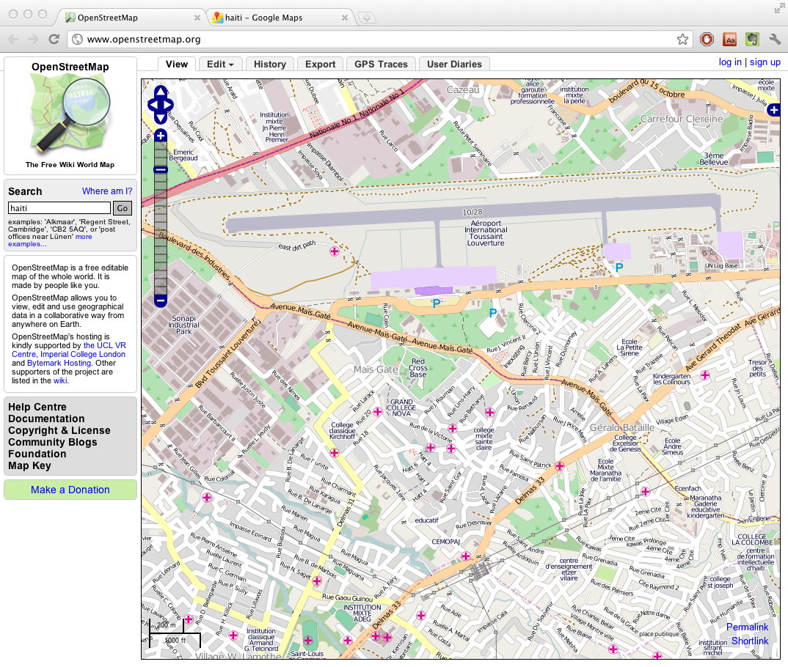
HOT
Humanitarian
OpenStreetMap
Team

Slide 16
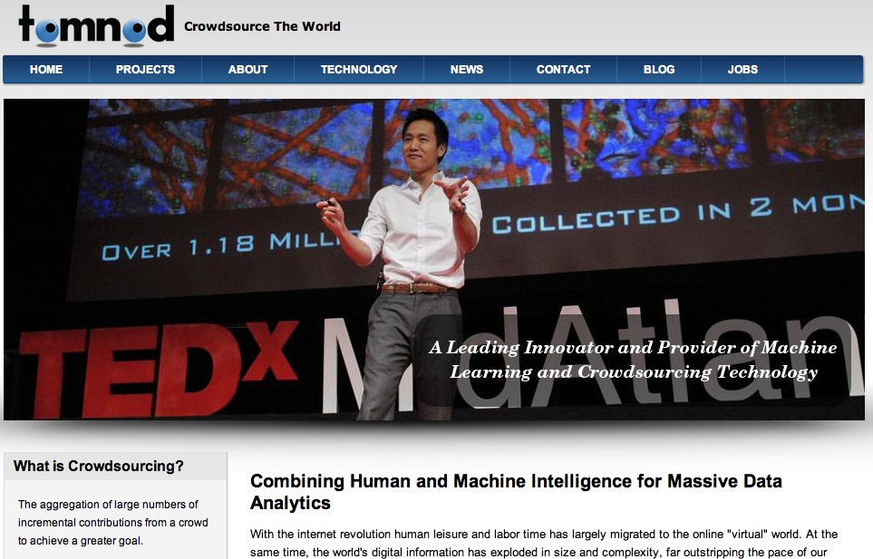
Massive data analytics http://tomnod.com

Slide 17
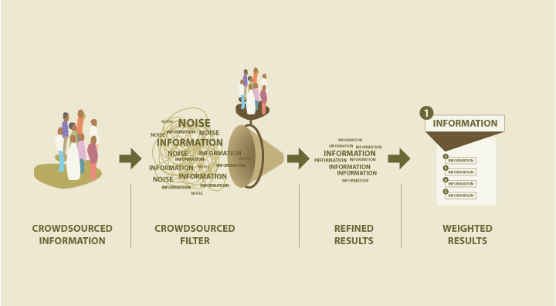
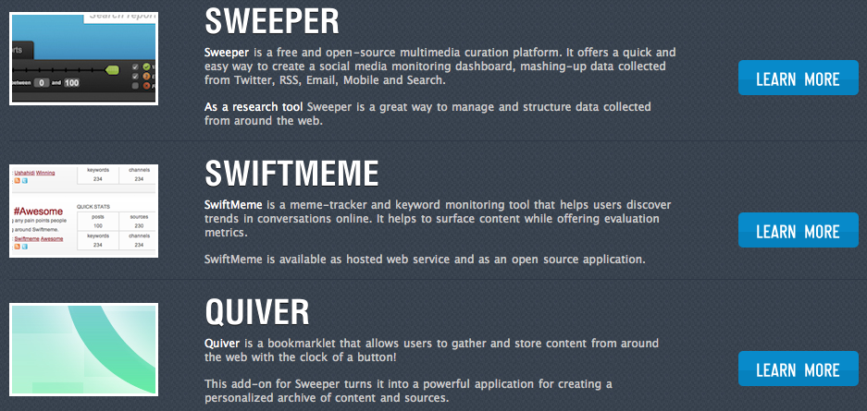
Ushahidi Swiftriver
Ushahidi SwiftRiver | http://ushahidi.com/products/swiftriver-platform
SwiftRiver is a platform that helps people make sense of a lot of information in a short amount of time.
In practice, SwiftRiver enables the filtering and verification of real-time data from channels like Twitter, SMS, Email and RSS feeds.
http://www.youtube.com/watch?v=Tb0Gs7vtrgk

Slide 18
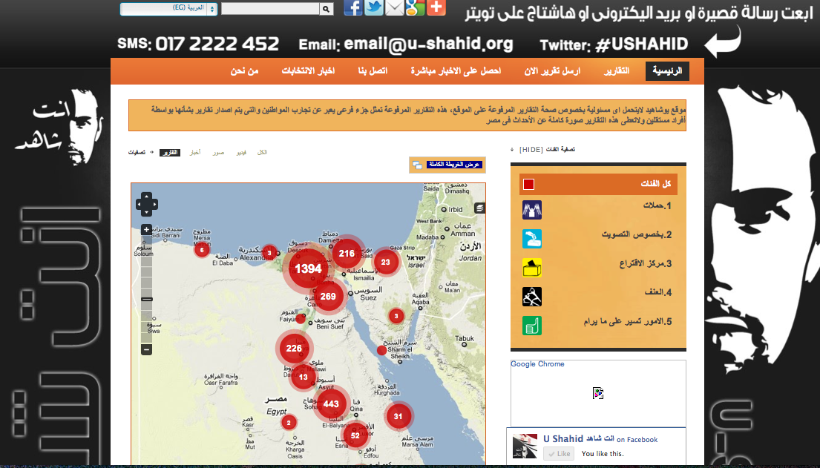

Slide 19
Submitting a report with ICT4Peace Matrix: Information Reliability
Notes:
Adressing the challenge of validation of information

Slide 20
Submitting a report with Matrix: Information Probability

Slide 21
Submitting a report with the Matrix: How the analyst can prioritize reports

Slide 22
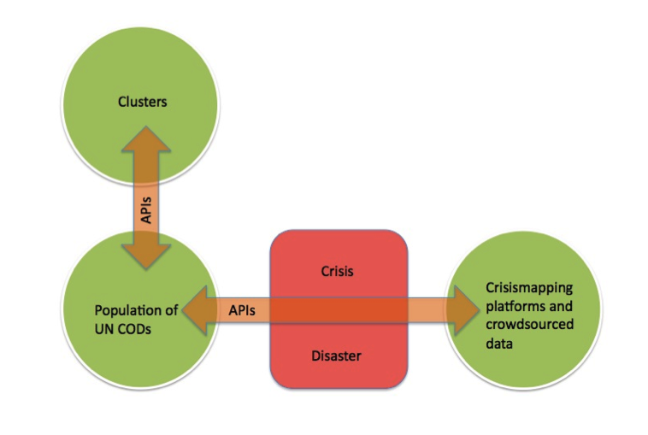
The ICT4Peace Foundation
The ICT4Peace Foundation aims to enhance the performance of the International community in crisis management through the use of ICTs that facilitates improved, effective and sustained communication between peoples, communities and stakeholders involved in conflict prevention, mediation and peace building through better understanding of and enhanced application of Information Communications Technology (ICT) including Media and Social Media.
ICT4Peace aims to facilitate a holistic, cohesive and collaborative mechanisms directly in line with Paragraph 36 of the World Summit on the Information Society (WSIS) Tunis Declaration (2005):
“36. We value the potential of ICTs to promote peace and to prevent conflict which, inter alia, negatively affects achieving development goals. ICTs can be used for identifying conflict situations through early-warning systems preventing conflicts, promoting their peaceful resolution, supporting humanitarian action, including protection of civilians in armed conflicts, facilitating peacekeeping missions, and assisting post conflict peace-building and reconstruction.”between peoples, communities and stakeholders involved in crisis management, humanitarian aid and peacebuilding.

Slide 23
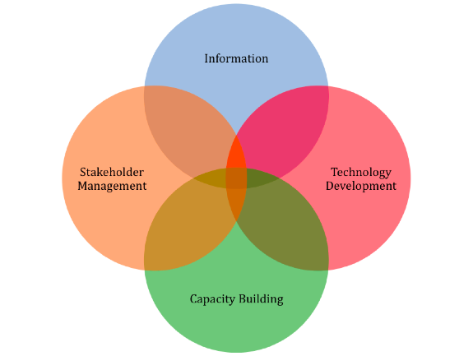
From Stock-Taking to CiMAG - UN Crisis Information Management Strategy (CiMS)

Slide 24
thank you www.ict4peace.org danielstauffacher@ict4peace.org

