Slide 1
“The Cyber Security Challenge: What Can be Done?” UNOG Executive Briefing 21 March 2014, Palais des Nations, UN Office in Geneva Presentation by Amb. (ret.) Daniel Stauffacher President, ICT4Peace Foundation www.ict4peace.org

Slide 2
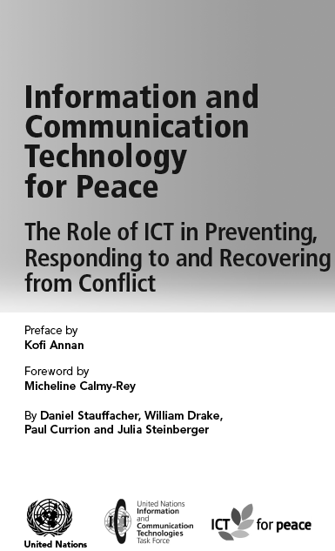
The Role of ICTs in Preventing, Responding to and Recovering from Conflict WSIS Tunis 2005 ICT4Peace/UN ICT Task Force (http://bit.ly/1bR0yPI)

Slide 3
The UN World Summit on the Information Society (WSIS) in Tunis 2005
Paragraph 36 of the World Summit on the Information Society (WSIS) Tunis Declaration (2005):
“36. We value the potential of ICTs to promote peace and to prevent conflict which, inter alia, negatively affects achieving development goals. ICTs can be used for identifying conflict situations through early-warning systems preventing conflicts, promoting their peaceful resolution, supporting humanitarian action, including protection of civilians in armed conflicts, facilitating peacekeeping missions, and assisting post conflict peace-building and reconstruction.”between peoples, communities and stakeholders involved in crisis management, humanitarian aid and peacebuilding.

Slide 4
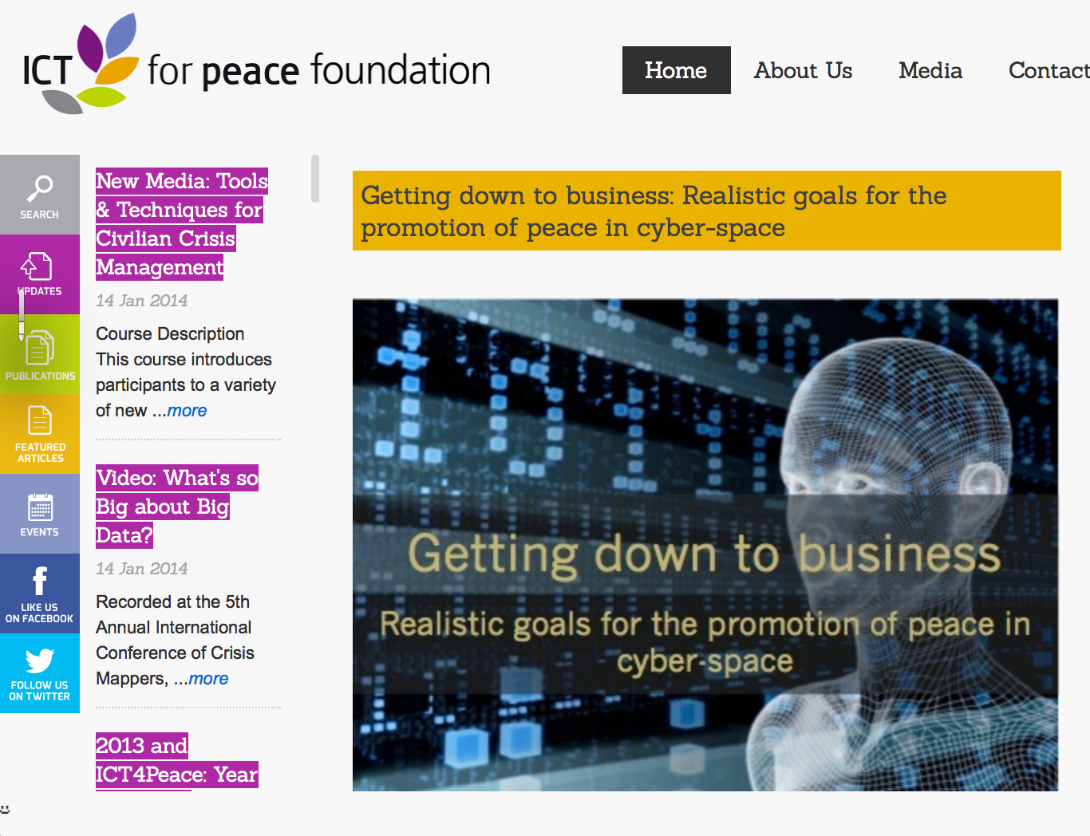
See Article by Barbara Weekes et al (2011): “Getting down to Business – Realistic Goals for the Promotion of Peace in the Cyberspace:
http://ict4peace.org/￼getting-down-to-business-realistic-goals-for-the-promotion-of-peace-in-cyber-space/
See list of articles by ICT4Peace on rights and security in the cyberspace: http://ict4peace.org/?p=1076.

Slide 5
ICT4Peace Report on Transparency and Confidence Building Measures (TCBMs)**
** see Report by Camino Kavanagh, Senior Advisor ICT4Peace:
http://ict4peace.org/what-next-building-confidence-measures-for-the-cyberspace/
ICT4Peace workshop at ETH Zurich June 2013 with the Support of the Swiss Ministry of Foreign Affairs

Slide 6
The Cybersecurity Challenge
Numerous states are pursuing military cyber-capabilities: UNIDIR Cyber Index: 114 national cyber security programs world-wide, 47 have cyber-security programs that give some role to the armed forces.
Cyber capabilities are not limited to great military powers. They transcend lines of state-centered warfare: A private cannot usually obtain, train and use weapons of war. In the electronic world they can.
The step from common crime to politically motivated acts, even terrorism, is not far.

Slide 7
Cyber Capabilities and traditional security calculus
An exclusive, all-out cyber-war has not happened yet, but they have as part of conflicts: 2007 against Estonia, 2008 against Georgia, 2010 against Iran, 2013 against South Korea. In the context of the Syrian war, denial-of-service attacks have been reported.
Cyber action can also create real damage in the physical world. The Stuxnet virus resulted in the destruction of equipment; Destruction of a country’ certain critical infrastructure: power, transport, financial sector etc. is feasible.
However, Cyber Capabilities do not fit traditional security strategies (deterrence, denial), because:
Problem of attribution of an attack
Rapidly evolving technology produced and in the hands of the private sector
Arms control agreements (so far) unrealistic for cyber capabilities
Multiple actors, both state and non-state actors
No commonly accepted definition of a cyber weapon so far

Slide 8
“The Cyber Security Challenge: What Can be Done?”
The potential cyber conflict scenarios are:
(1) all-out cyber-war (unlikely)
(2) the limited use of cyber capabilities as part of a larger war effort (partly to-day)
(3) an international military crisis escalating from a cyber-action (possible).
These scenarios show that we need:
to engage in an international discussion on the norms and principles of responsible state behavior in cyber space, including on the conduct of cyber warfare, and its possible exclusion or mitigation (Tallinn Manual a beginning)
In order to establish a universal understanding of the norms and principles of responsible state behavior in cyber space, we need to turn to the United Nations (such as UN GA, UNGGE, WSIS Geneva Action Line 5)
To prevent an escalation we need to develop Confidence Building Measures (e.g. Bilateral Agreements, OSCE, ARF, UN GGE)
Continue the London – Budapest - Seoul Conferences Process on Cyberspace to create political awareness and reach out to other regions and actors

Slide 9
CBMs: Important Progress at OSCE
Important Progress at the OSCE in December 2013: Participating States, approved a first set of voluntary confidence-building measure:
Providing their national views on various aspects of national and transnational threats to and in the use of Information and Communication Technologies;
Facilitating co-operation among the competent national bodies and exchanging information;
Holding consultations in order to reduce the risks of misperception, and of possible emergence of political or military tension or conflict that may stem from the use of Information and Communication Technologies;
Sharing information on measures that they have taken to ensure an open, interoperable, secure, and reliable Internet , and on their national organization; strategies; policies and programs;
Using the OSCE as a platform for dialogue, exchange of best practices, awareness-raising and information on capacity-building;
Nominating contact points; and
Providing a list of relevant national terminology.
OSCE Participating States have agreed that they will, at the level of designated national experts, meet at least three times each year, to discuss information exchanged and explore appropriate development of CBMs.

Slide 10
WSIS 2003 Geneva Plan of Action Follow-up towards 2015, MDGs and beyond Action Line C5. Building confidence and security in the use of ICTs
12. Confidence and security are among the main pillars of the Information Society.
Promote cooperation among the governments at the United Nations and with all stakeholders at other appropriate fora to enhance user confidence, build trust, and protect both data and network integrity; consider existing and potential threats to ICTs; and address other information security and network security issues.
Governments, in cooperation with the private sector, should prevent, detect and respond to cyber-crime and misuse of ICTs by: developing guidelines that take into account ongoing efforts in these areas; considering legislation that allows for effective investigation and prosecution of misuse; promoting effective mutual assistance efforts; strengthening institutional support at the international level for preventing, detecting and recovering from such incidents; and encouraging education and raising awareness.
Governments, and other stakeholders, should actively promote user education and awareness about online privacy and the means of protecting privacy.
Take appropriate action on spam at national and international levels.
Encourage the domestic assessment of national law with a view to overcoming any obstacles to the effective use of electronic documents and transactions including electronic means of authentication.
Further strengthen the trust and security framework with complementary and mutually reinforcing initiatives in the fields of security in the use of ICTs, with initiatives or guidelines with respect to rights to privacy, data and consumer protection.
Share good practices in the field of information security and network security and encourage their use by all parties concerned.

Slide 11
WSIS 2003 Geneva Plan of Action and Follow-up towards 2015, MDGs and beyond Action Line C5. Building confidence and security in the use of ICTs
Invite interested countries to set up focal points for real-time incident handling and response, and develop a cooperative network between these focal points for sharing information and technologies on incident response.
Encourage further development of secure and reliable applications to facilitate online transactions.
Encourage interested countries to contribute actively to the ongoing United Nations activities to build confidence and security in the use of ICTs.

Slide 12
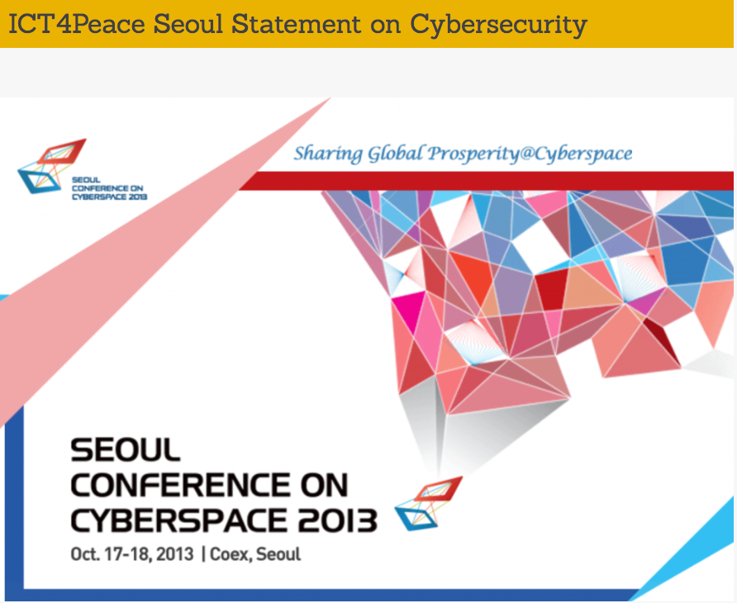
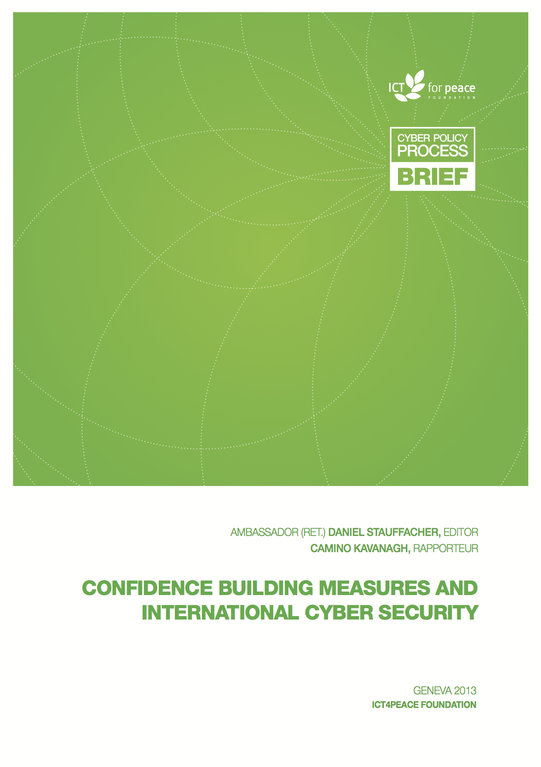
International Processes: Council of Europe, OSCE, UN GGE, London, ARF Example CBMs
Cybersecurity and Resilient Internet
Report on Ict4Peace Workshop and Statement to Seoul Conference Plenary:
http://ict4peace.org/seoul-conference-on-cyberspace-2013-statement-on-ict4peace-special-session/
Notes:
Lybia Standby force

Slide 14
Thank you very much
danielstauffacher@ict4peace.org

