Slide 1
ICT4Peace Foundation Presentation at Federal Foreign Office, Germany Berlin, 23 April 2015 Dr. Daniel Stauffacher, President, ICT4Peace Foundation www.ict4peace.org

Slide 3
ICT4Peace interlinked Areas of Work: 1. CRISIS Information Management including using ICTs, new media etc. 2. Cyber Security

Slide 4
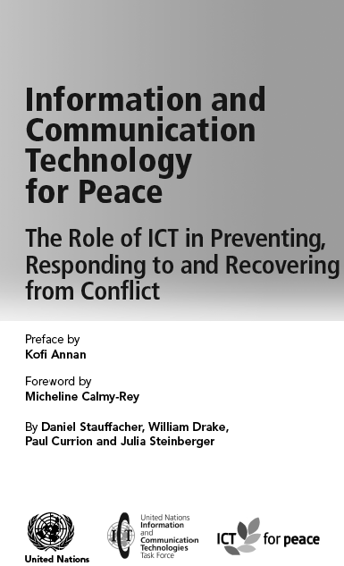
The Role of ICTs in Preventing, Responding to and Recovering from Conflict WSIS Tunis 2005 ICT4Peace/UN ICT Task Force (http://bit.ly/1bR0yPI)

Slide 5
The UN World Summit on the Information Society (WSIS) in Tunis 2005
Paragraph 36 of the World Summit on the Information Society (WSIS) Tunis Declaration (2005):
“36. We value the potential of ICTs to promote peace and to prevent conflict which, inter alia, negatively affects achieving development goals. ICTs can be used for identifying conflict situations through early-warning systems preventing conflicts, promoting their peaceful resolution, supporting humanitarian action, including protection of civilians in armed conflicts, facilitating peacekeeping missions, and assisting post conflict peace-building and reconstruction.”between peoples, communities and stakeholders involved in crisis management, humanitarian aid and peacebuilding.

Slide 6
UN Secretary-General 2010 Crisis Information Strategy (A/65/491)
Crisis information management strategy. The Crisis Information Management Strategy is based on the recognition that the United Nations, its Member States, constituent agencies and non-governmental organizations need to improve such information management capacity in the identification, prevention, mitigation, response and recovery of all types of crises, natural as well as man- made. The strategy will leverage and enhance this capacity and provide mechanisms to integrate and share information across the United Nations system.
The Office of Information and Communications Technology (CITO), together with the Office for the Coordination of Humanitarian Affairs (OCHA), the Department of Peacekeeping Operations and the Department of Field Suppor (DPKO and DFS), has worked closely with United Nations organizations such as the Office of the United Nations High Commissioner for Refugees (UNHCR), the United Nations Children’s Fund (UNICEF), the United Nations Development Programme (UNDP) and WFP and other entities such as the ICT for Peace Foundation in developing and implementing this strategy. It is envisaged that membership will be expanded to include other United Nations organizations in the near future.

Slide 7
CIM Strategy
CiMS
Vision
Business Drivers
Technology Drivers
STRATEGIC PROGRAMMES
Information
Architecture/
Governance
Technology
Development
Stakeholder
Management
Capacity
Building
Critical Success Factors
Leadership
Funding
Evaluation
Incrementalism
Outcomes

Slide 8
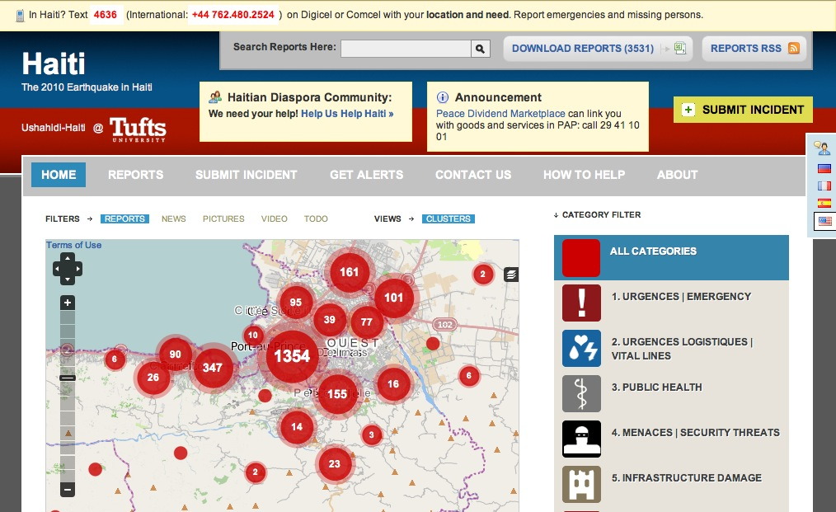
New Tools: Mapping and Crowdsourcing for CiM - Learning from Kenya 2007, Haiti 2010, Libya, Typhoon Yolanda etc. etc.
Technology Development Programme
Notes:
Crowdsourcing : Too much information
8

Slide 9
Information break-down in crisis situation
New media
Twitter
Flickr
Mainstream media
CNN / BBC / Al Jazeera
Local / National TV and radio
Sit reps
Humanitarian Information Centres
Blogs
SMS / MMS / Mobiles
Print media (mainstream / regional)
Agency databases / email lists
Personal contacts / relationships
Social networks
Alternative print media
Open Data Open Gov Data
Traditional Sources
GIS

Slide 10
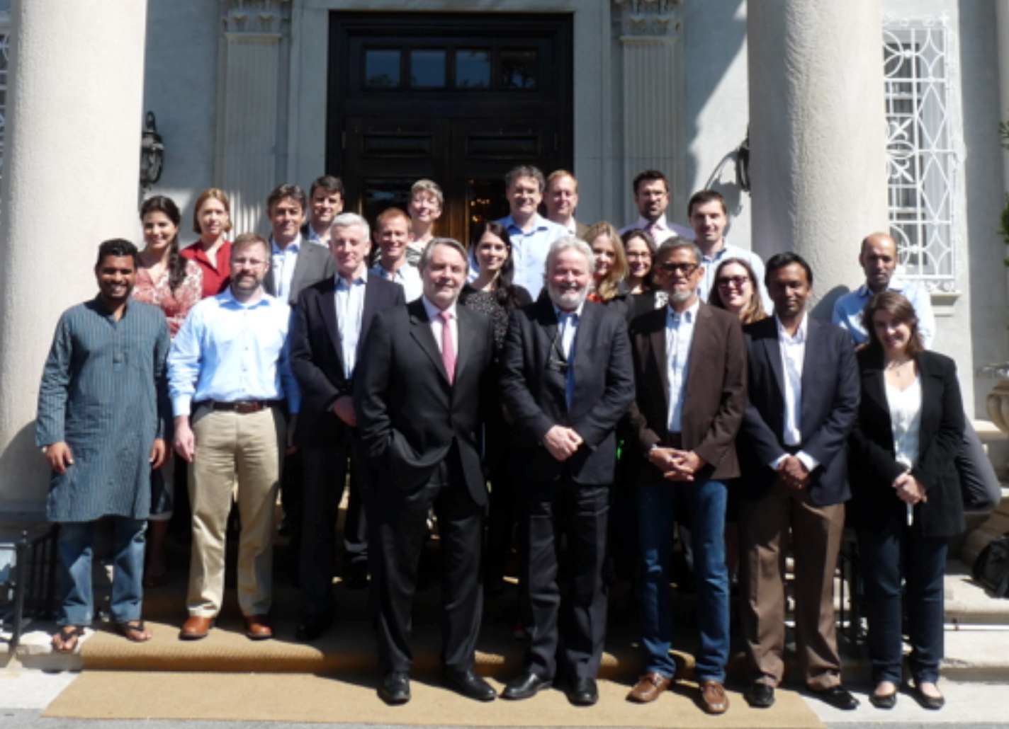
UN Crisis Information Management Advisory Group (CIMAG)

Slide 11
Improving Crisis Information Management in the Field: MONUSCO

Slide 12
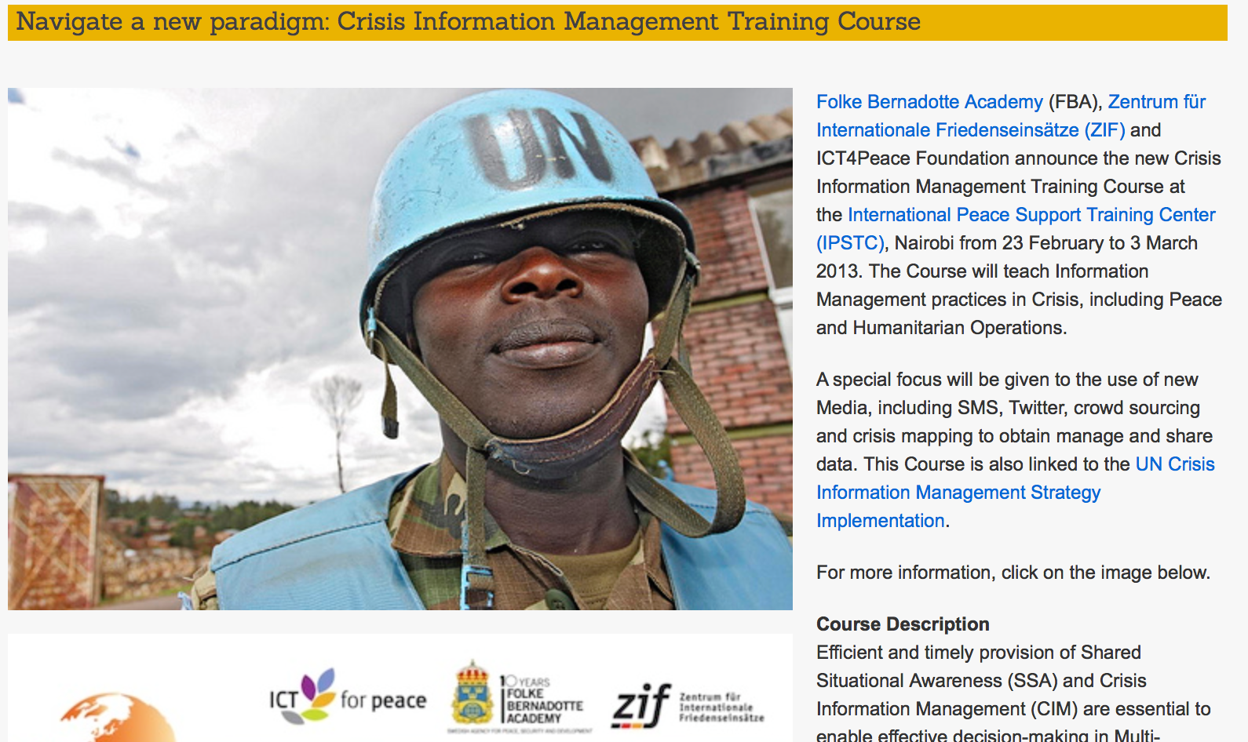
CiM Training Course for IM using ICTs and big data, social and new media, ENTRI Course in Cooperation with ZIF and FBA

Slide 13
Next Steps
Introduce CiM into UN budgets (regular and voluntary)
Possible funding sources/budgets:
Central Emergency Response Fund (CERF) (voluntary contributions) by OCHA
Peacekeeping mission budgets (incl Support Account, UNLB and UNSB-V) (assessed on peacekeeping scale approved by 5th C) by DPKO/DFS
Special political missions (RB funding approved by 5th C) by DPA
Programme Budget (rb) for the United Nations incl OICT (approved by 5th C) by OICT
Monitoring and Ex–Post Evaluation of CiM Activities in PK Operations
Like any other Program and Project activity CiM SA activities should be monitored
and evaluated by PK Missions DPKO/DFS, OCHA and Country Teams and
United Nations Office of Internal Oversight Services (OIOS)

Slide 14
A Breakthrough at UN GA (5th Committee) in December 2014
In December 2014, the UN General Assembly approved the update of the UN Secretary-General’s updated Strategy (A/69/517), to better exploit the enormous potential of Information and Communications Technologies (ICT) for decision-making and delivery capacity of the United Nations in the areas of peace and security, humanitarian operations and development, human rights and international law.
“Analytics could assist in crisis management efforts and the Office would seek to work with the Crisis Information Management Advisory Group (CiMAG) to seek to explore this further.”
Subsequently, the General Assembly in its resolution dated 26 December 2014 (A/C.5/69/L.26*) welcomed the new Information and Communications Technology Strategy in the United Nationsl, and requested the Sg to provide, in 2015, detailed information on the implementation.
The General Assembly called on the Secretary-General to continue his efforts to reduce the level of fragmentation of the current information and communications technology environment across the Secretariat and at all duty stations and field missions.

Slide 15
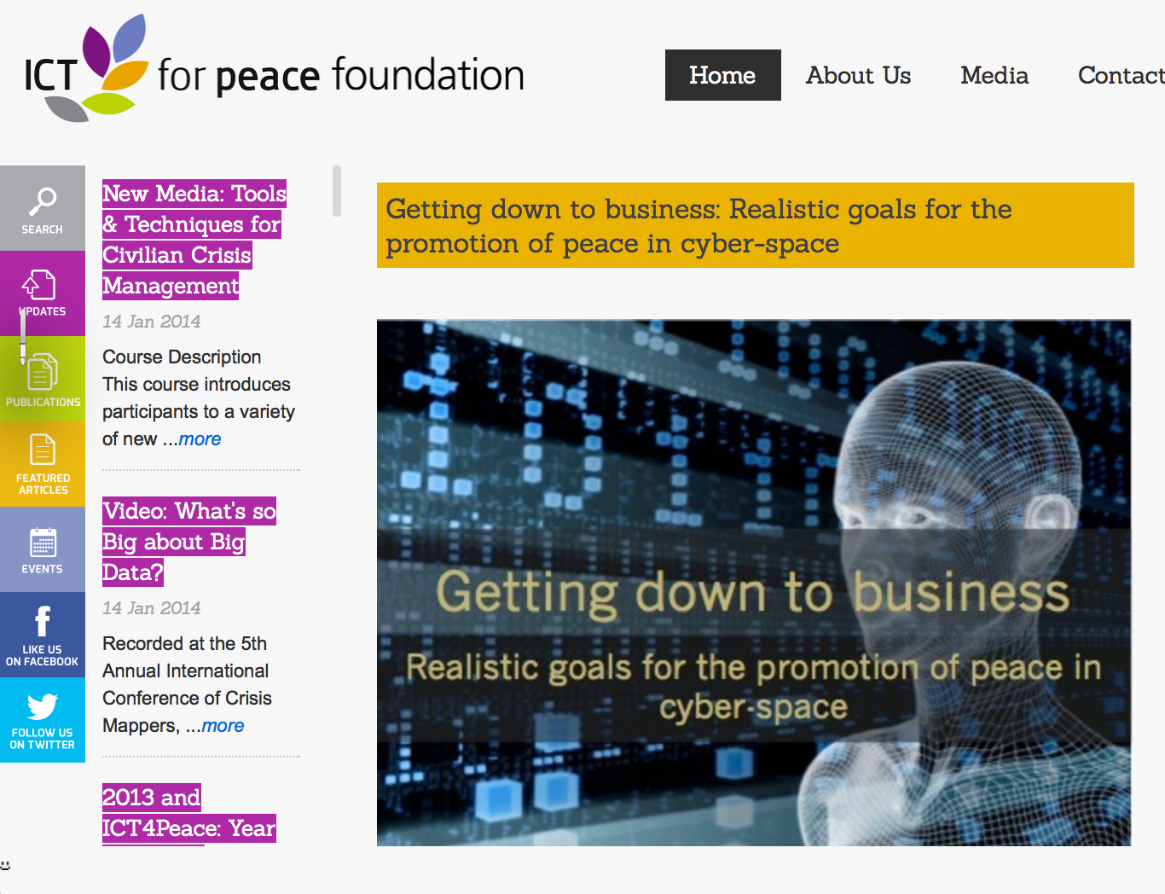
See Article by Barbara Weekes et al (2011): “Getting down to Business – Realistic Goals for the Promotion of Peace in the Cyberspace:
http://ict4peace.org/￼getting-down-to-business-realistic-goals-for-the-promotion-of-peace-in-cyber-space/
See list of articles by ICT4Peace on rights and security in the cyberspace: http://ict4peace.org/?p=1076.

Slide 16
The Cybersecurity Challenge
Numerous states are pursuing military cyber-capabilities: UNIDIR Cyber Index: more than 114 national cyber security programs world-wide, more than 47 have cyber-security programs that give some role to the armed forces.
Cyber capabilities are not limited to great military powers. They transcend lines of state-centered warfare: A private cannot usually obtain, train and use weapons of war. In the electronic world they can.
The step from common crime to politically motivated acts, even terrorism, is not far.

Slide 17
Erosion of Trust
Trust between states and between state and citizens is increasingly eroding by a range of state practices, including with regard to the negative uses of information communications technologies and related capabilities to advance political, military and economic goals.
The interest in these state practises have inadvertedly also been stoked by developments such as:
-The role ICTs have played recently in the Middle East and North Africa;
- The alleged state use of sophisticated malware such as Stuxnet to achieve foreign policy goals;
- and Edward Snowden’s disclosures on the monitoring and surveillance practices.
Despite a range of domestic and diplomatic efforts initiated to curb such practices, many states have rushed to develop these same capabilities to use not only against other states but against their own citizens, which further undermined confidence and trust between states, and between states and citizens.

Slide 18
“The Cyber Security Challenge: What Can be Done?”
These scenarios show that Think Tanks, Academia, Civil Society and Private Sector need:
to engage in an international discussion on the norms and principles of responsible state behavior in cyber space, including on the conduct of cyber warfare, and its possible exclusion or mitigation (Tallinn Manual a beginning)
we need to turn to the United Nations (such as UN GA, UNGGE, WSIS Geneva Action Line 5)
To prevent an escalation we need to develop Confidence Building Measures CBMs (e.g. Bilateral Agreements, OSCE, ARF, UN GGE)
Continue the London – Budapest – Seoul – The Hague Conferences Process on Cyberspace to create political awareness and reach out to other regions and actors (through inter alia training)

Slide 19
What Role for Civil Society and Industry in Furthering CyberSECURITY-RELATED Norms and CBMs, particularly given the UN GGE and OSCE breakthroughs ?
Proposed areas of work for think tanks, academia, business and civil society:
Transparency and Accountability;
ii) Participation;
and iii) Deepening the Knowledge Base.

Slide 21
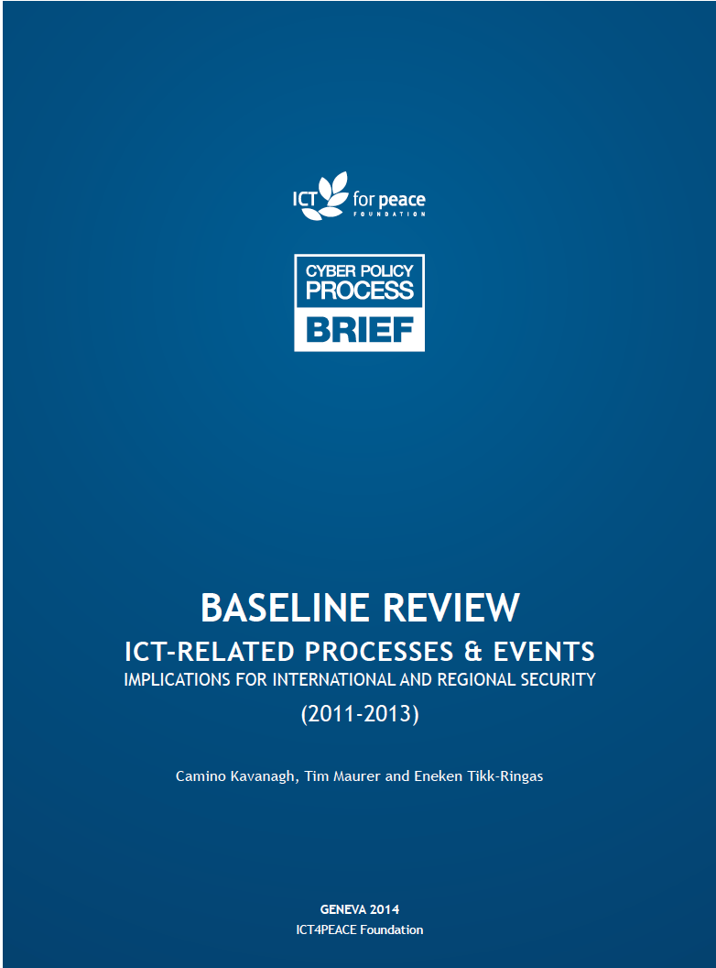

Slide 22
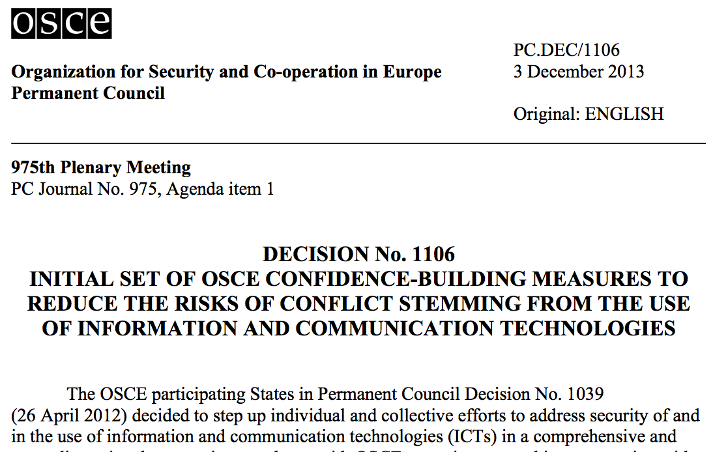
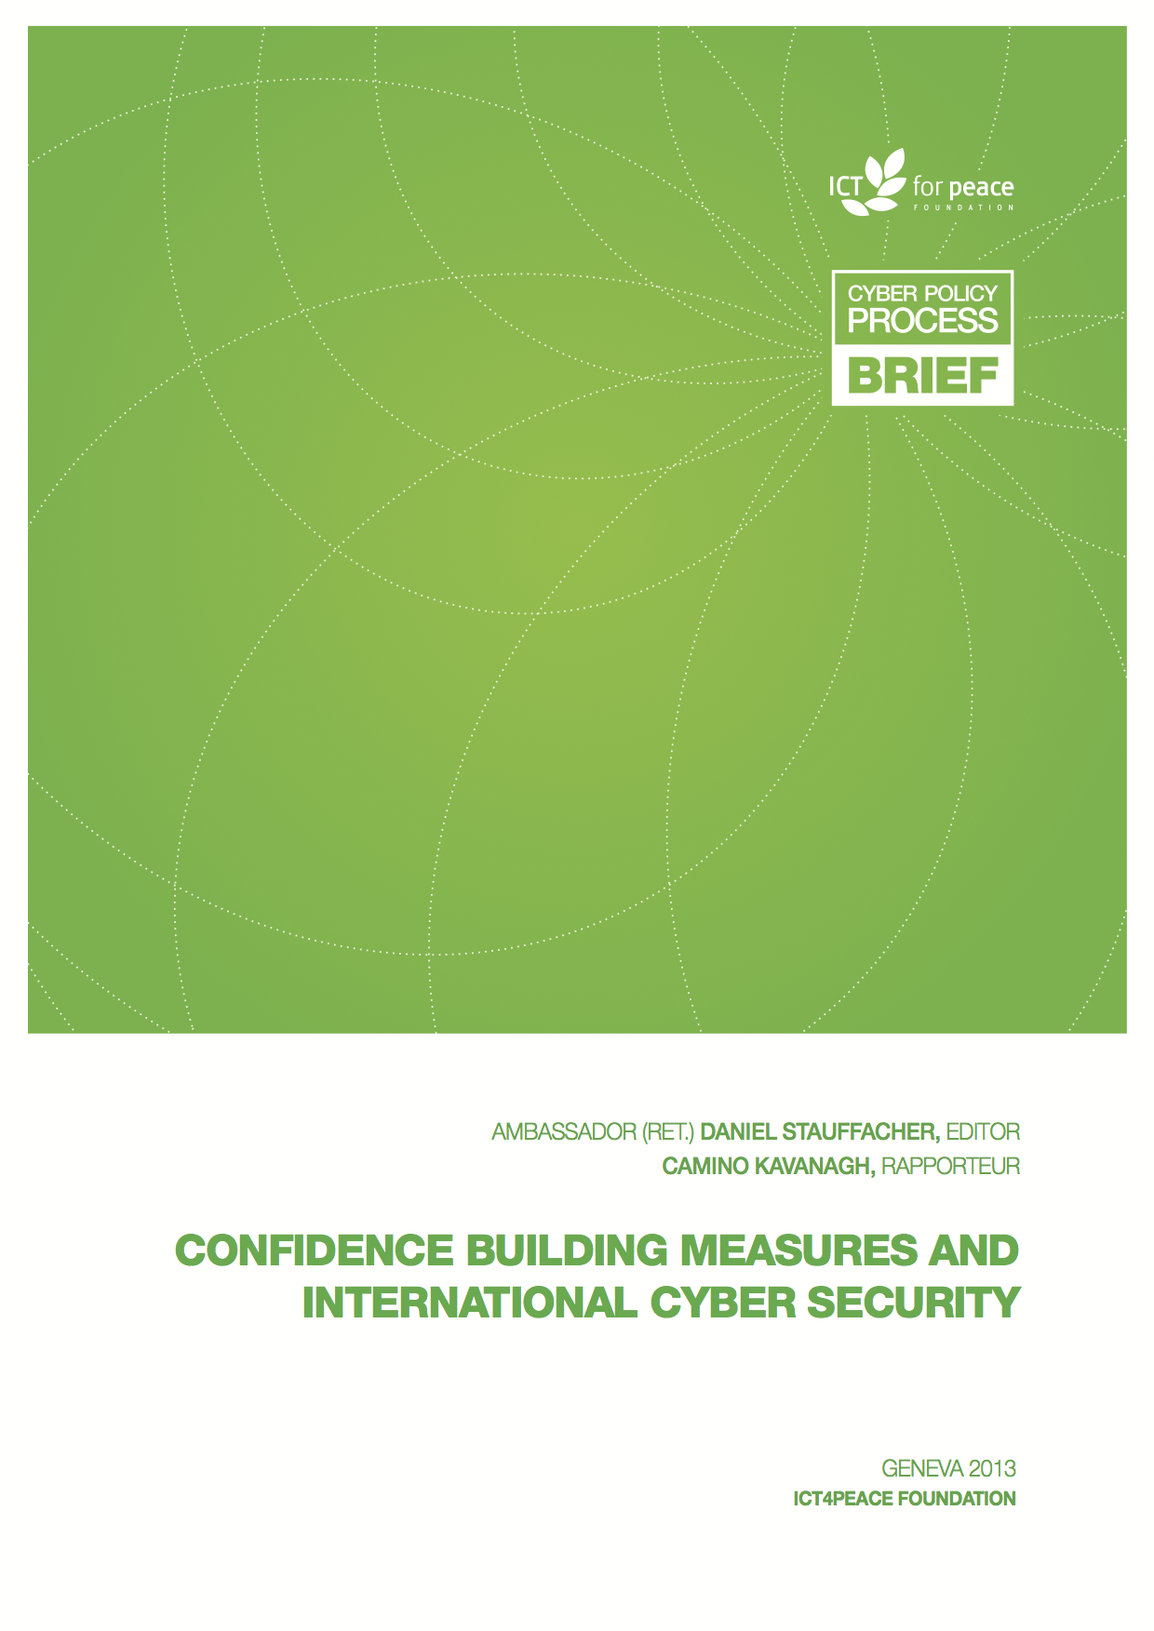
International Processes: Council of Europe, OSCE, UN GGE, London, ARF Example CBMs
Cybersecurity and Resilient Internet
Notes:
Lybia Standby force

Slide 23
ICT4Peace Report on Transparency and Confidence Building Measures (TCBMs)**
** see Report by Camino Kavanagh, Senior Advisor ICT4Peace:
http://ict4peace.org/what-next-building-confidence-measures-for-the-cyberspace/
ICT4Peace workshop at ETH Zurich June 2013 with the Support of the Swiss Ministry of Foreign Affairs

Slide 24
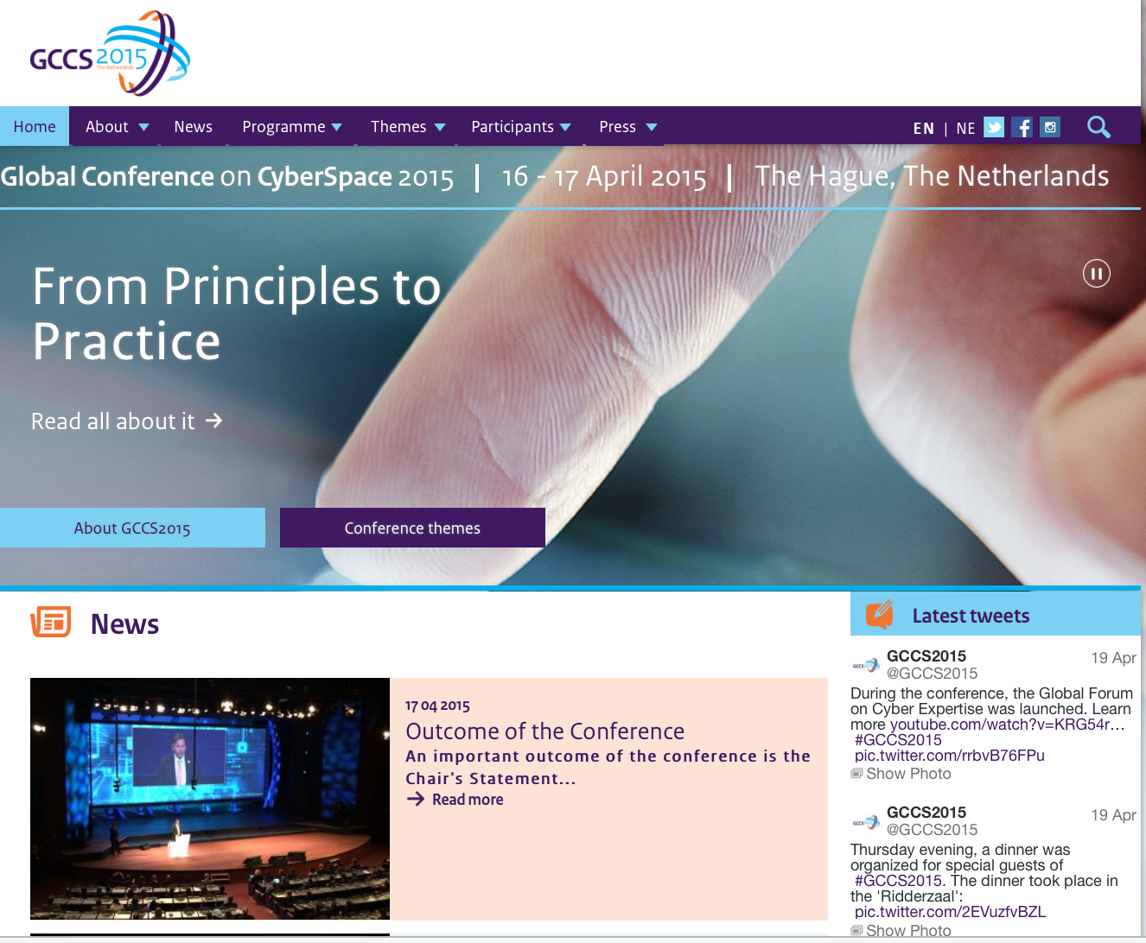
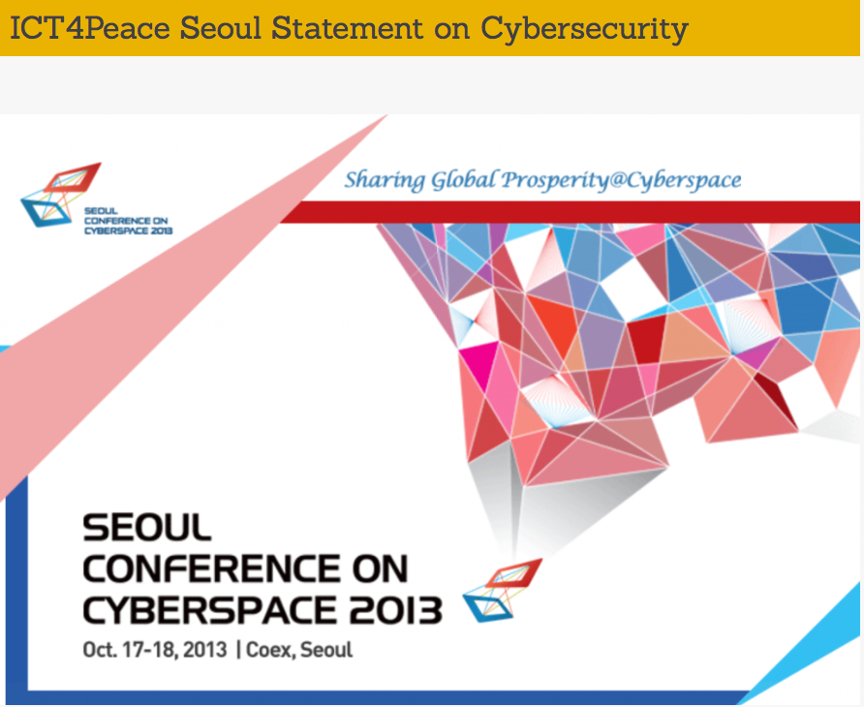
International Processes: Council of Europe, OSCE, UN GGE, London, ARF Example CBMs
Cybersecurity and Resilient Internet
Report on Ict4Peace Workshop and Statement to Seoul Conference Plenary:
http://ict4peace.org/seoul-conference-on-cyberspace-2013-statement-on-ict4peace-special-session/
Notes:
Lybia Standby force

Slide 25
A Comprehensive Normative Approach to Cyber Security Presented at GCCS 2015
International norms
Legal (binding) norms
Political (non-binding) norms
Hard law
Soft law
Non-legal norms
Binding norms
(treaties, custom, general principles)
Binding norms with a soft dimension*
Non-binding norms of legal relevance*
Non-binding or voluntary norms
(e.g. CBMs)
* See Fabien Terpan, Soft Law in the European Union—The Changing Nature of EU Law, European Law Journal, Volume 21, Issue 1, pages 68–96, January 2015
Notes:
----- Meeting Notes (3/4/15 11:21) -----
Not just what areas of law are relevant (the right end of the spectrum, where LOAC only constitutes less than 5% of all the remedies that we have)
All these mechanisms can be used for conflict prevention, if we apply them systematically and skillfully to the issues at hand.

Slide 26
WSIS 2003 Geneva Plan of Action Follow-up towards WSIS plus 10 in 2015, MDGs and beyond Action Line C5. Building confidence and security in the use of ICTs
12. Confidence and security are among the main pillars of the Information Society.
Promote cooperation among the governments at the United Nations and with all stakeholders at other appropriate fora to enhance user confidence, build trust, and protect both data and network integrity; consider existing and potential threats to ICTs; and address other information security and network security issues.
Governments, in cooperation with the private sector, should prevent, detect and respond to cyber-crime and misuse of ICTs by: developing guidelines that take into account ongoing efforts in these areas; considering legislation that allows for effective investigation and prosecution of misuse; promoting effective mutual assistance efforts; strengthening institutional support at the international level for preventing, detecting and recovering from such incidents; and encouraging education and raising awareness.
Governments, and other stakeholders, should actively promote user education and awareness about online privacy and the means of protecting privacy.
Take appropriate action on spam at national and international levels.
Encourage the domestic assessment of national law with a view to overcoming any obstacles to the effective use of electronic documents and transactions including electronic means of authentication.
Further strengthen the trust and security framework with complementary and mutually reinforcing initiatives in the fields of security in the use of ICTs, with initiatives or guidelines with respect to rights to privacy, data and consumer protection.
Share good practices in the field of information security and network security and encourage their use by all parties concerned.

Slide 27
UN GA THIRD COMMITTEE APPROVES TEXT TITLED ‘RIGHT TO PRIVACY IN THE DIGITAL AGE’**
It calls on states to review procedures, practices and legislation on communications surveillance and "to establish or maintain existing independent, effective domestic oversight mechanisms capable of ensuring transparency, as appropriate, and accountability for State surveillance of communications, their interception and collection of personal data."
It also asks U.N. human rights chief Navi Pillay to present a report to the U.N. Human Rights Council and the U.N. General Assembly on the protection and promotion of the right to privacy in domestic and extraterritorial surveillance and the interception of digital communications and collection of personal data, including on a mass scale.
The difficult political and legal questions underlying references to “unlawful interference with privacy” and constraints on “extraterritorial surveillance” will keep lawyers and diplomats busy for months if not years to come.
At the same time, the challenge of reconciling the occasionally conflicting imperatives of ensuring national security and respecting human rights cannot be ignored by governments or citizens alike. At the multilateral level, the UN will have to begin to address the cyber security issue in a more coherent fashion.
The General Assembly can ill afford to have two deliberative streams (i.e. the First and Third Committee) acting in ignorance of one another. The airing of declaratory policy at the annual General Assembly sessions should not substitute for purposeful action by states in more operational forums to tackle the pressing problems raised by destabilizing state conducted cyber operations.
(**See also Paul Meyer: http://ict4peace.org/cyber-security-takes-the-un-floor/)

Slide 29
ICT4Peace Cybersecurity policy and diplomacy capacity building program with different regional organisations.

Slide 30
Vielen Dank danielstauffacher@ict4peace.org

