Slide 1

The International Cooperation Roundtable: The Human Factor
Tel Aviv University 26 June 2017
Dr. Daniel Stauffacher, President, ICT4Peace Foundation www.ict4peace.org

Slide 2
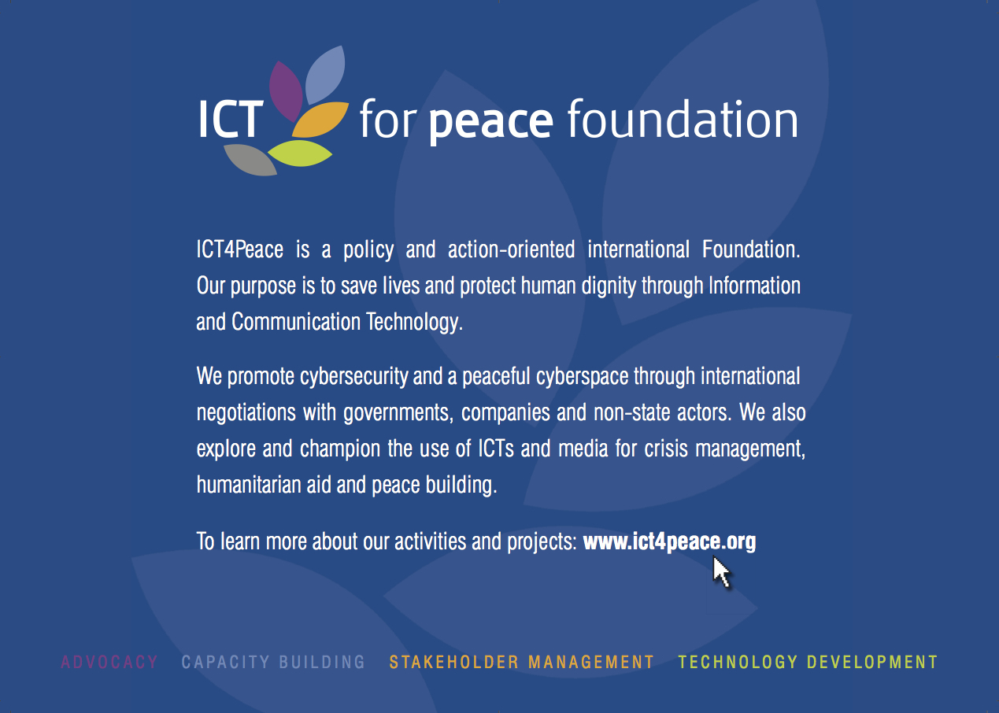

Slide 3
The UN World Summit on the Information Society (WSIS) in Geneva 2003 Tunis 2005
Paragraph 36 of the World Summit on the Information Society (WSIS) Tunis Commitment (2005):
“36. We value the potential of ICTs to promote peace and to prevent conflict which, inter alia, negatively affects achieving development goals. ICTs can be used for identifying conflict situations through early-warning systems preventing conflicts, promoting their peaceful resolution, supporting humanitarian action, including protection of civilians in armed conflicts, facilitating peacekeeping missions, and assisting post conflict peace-building and reconstruction between peoples, communities and stakeholders involved in crisis management, humanitarian aid and peacebuilding.”

Slide 4
ICT4Peace’s interlinked Areas of Work:
1. Since 2004 Better Crisis Information Management using ICTs, new media etc. by the international community/UN for inter alia humanitarian operations, peace-keeping and peace building;
2. Peace and Security in the Cyberspace (to maintain an open, secure, stable, accessible and peaceful ICT environment.

Slide 5
UN Secretary-General 2010 Crisis Information Strategy
(A/65/491)
Crisis information management strategy. The Crisis Information Management Strategy is based on the recognition that the United Nations, its Member States, constituent agencies and non-governmental organizations need to improve such information management capacity in the identification, prevention, mitigation, response and recovery of all types of crises, natural as well as man- made. The strategy will leverage and enhance this capacity and provide mechanisms to integrate and share information across the United Nations system.
The Office of Information and Communications Technology (CITO), together with the Office for the Coordination of Humanitarian Affairs (OCHA), the Department of Peacekeeping Operations and the Department of Field Suppor (DPKO and DFS), has worked closely with United Nations organizations such as the Office of the United Nations High Commissioner for Refugees (UNHCR), the United Nations Children’s Fund (UNICEF), the United Nations Development Programme (UNDP) and WFP and other entities such as the ICT for Peace Foundation in developing and implementing this strategy. It is envisaged that membership will be expanded to include other United Nations organizations in the near future.

Slide 6
CIM Strategy
CiMS
Vision
Business Drivers
Technology Drivers
STRATEGIC PROGRAMMES
Information
Architecture/
Governance
Technology
Development
Stakeholder
Management
Capacity
Building
Critical Success Factors
Leadership
Funding
Evaluation
Incrementalism
Outcomes

Slide 7
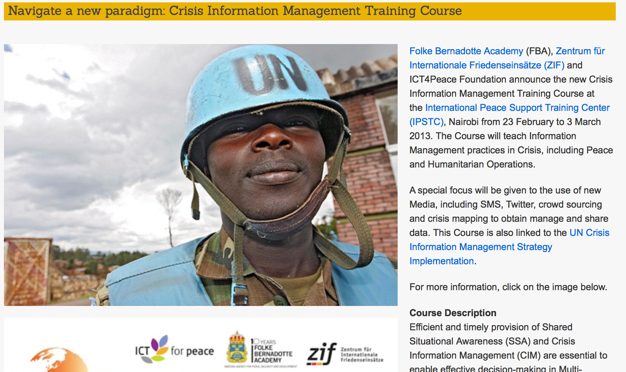
Training Courses for better Crisis Information Management using ICTs and big data, social and new media,

Slide 8
New Media Course: Tools & Techniques for Risk Assessment and Crisis Management
In a crisis, quick and informed decision-making matters.

Slide 9
Overview
This course introduces participants to a variety of new and social media tools, platforms and apps used in the collection, presentation, verification and dissemination of critical information in a timely manner.
Participants have the chance to do hands-on exercises using these tools through interactive activities and group work, while also learning about cyber-security to protect information, communications and sources.
A new and comprehensive module introduces ways on how to identify and guard against the intent of fake news, particularly over social media.

Slide 10
Why?
Paradoxically, efficient and effective responses, risk management and decision making is proving ever more elusive as more and more information surrounds us.
Actors with the capability to rapidly spread disinformation & misinformation, with a view to sociopolitical disruption
The challenge around differentiating signals from noise is significant in our social media age.
Everyone - parent, teacher, caregiver, activist, professional, humanitarian, lawyer, journalist, citizen - is a decision-maker. Media literacy - the ability to critically question the media we consume - is critical in a post-factual age where weaponized bots and other technologies hack our elections, society and politics.
The inability for institutions and individuals to keep pace with the information landscape

Slide 11
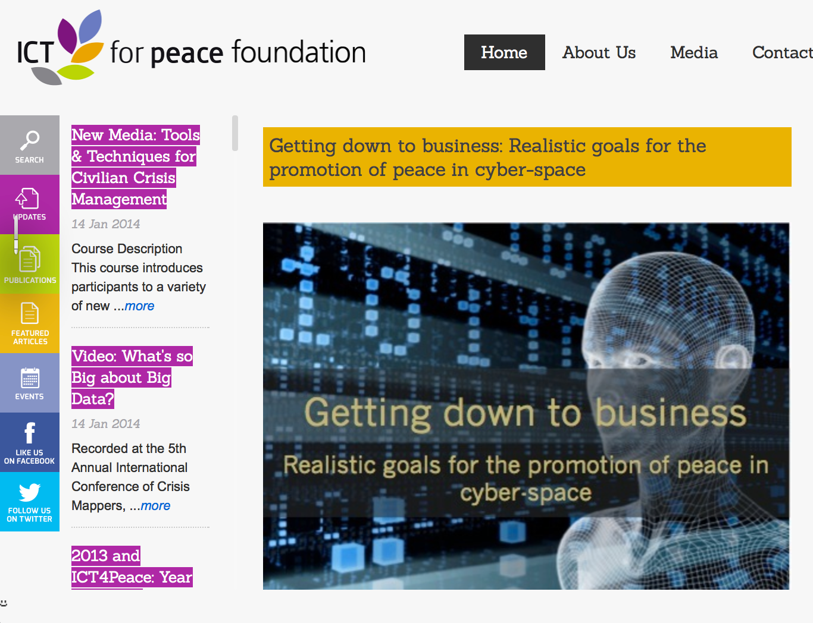
See Article by Barbara Weekes et al (2011): “Getting down to Business – Realistic Goals for the Promotion of Peace in the Cyberspace:
http://ict4peace.org/￼getting-down-to-business-realistic-goals-for-the-promotion-of-peace-in-cyber-space/
See list of articles by ICT4Peace on rights and security in the cyberspace: http://ict4peace.org/?p=1076.

Slide 12

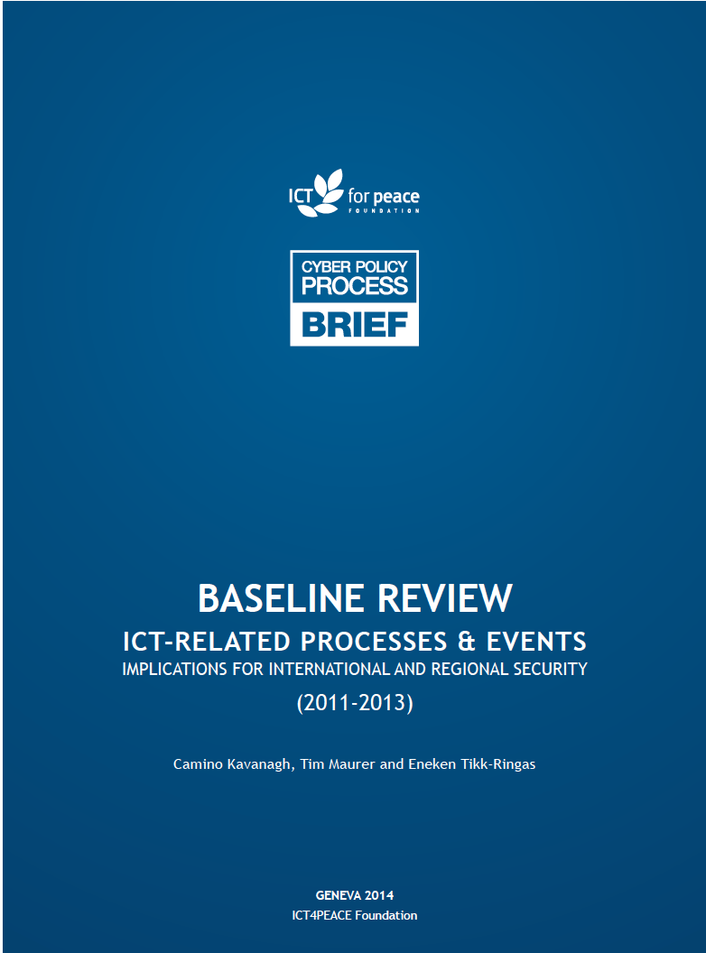

ICT4Peace Policy Research and Capacity Building on Peace, Trust and Security in Cyberspace

Slide 13
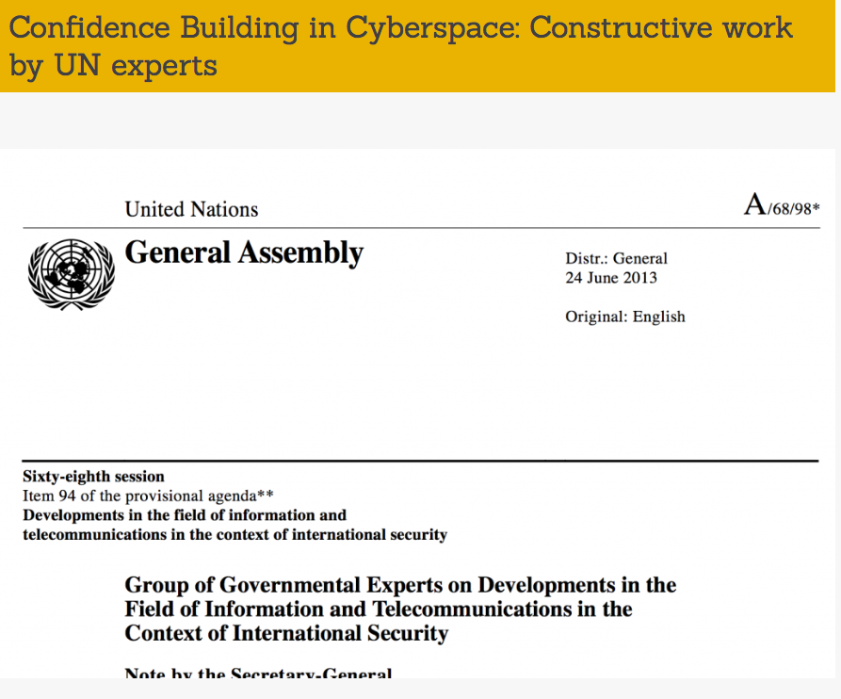
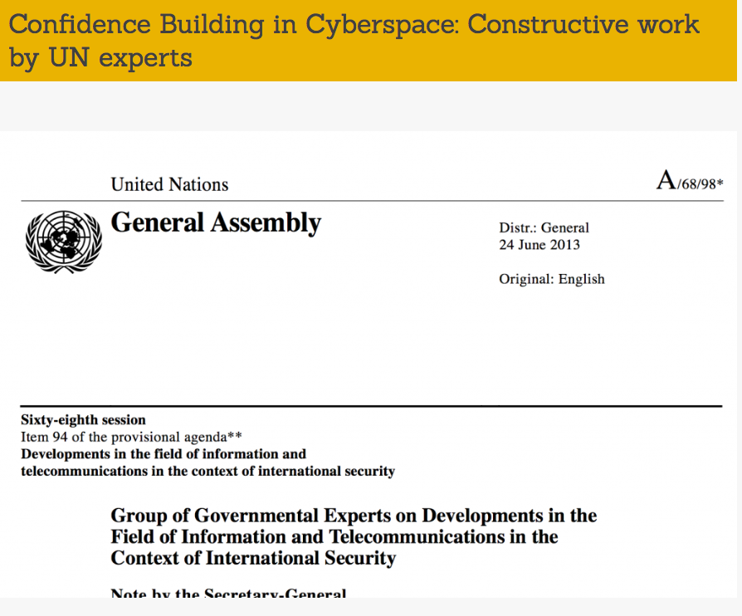
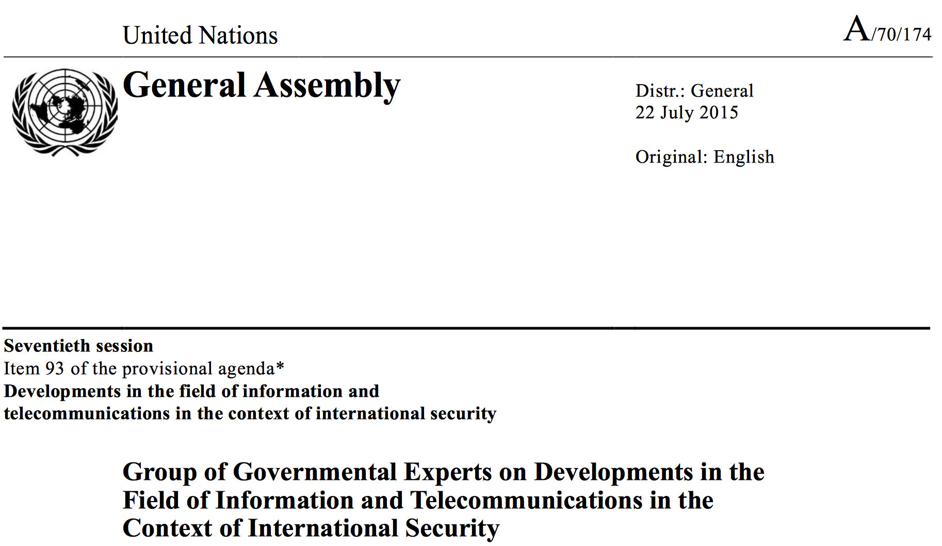

Slide 14
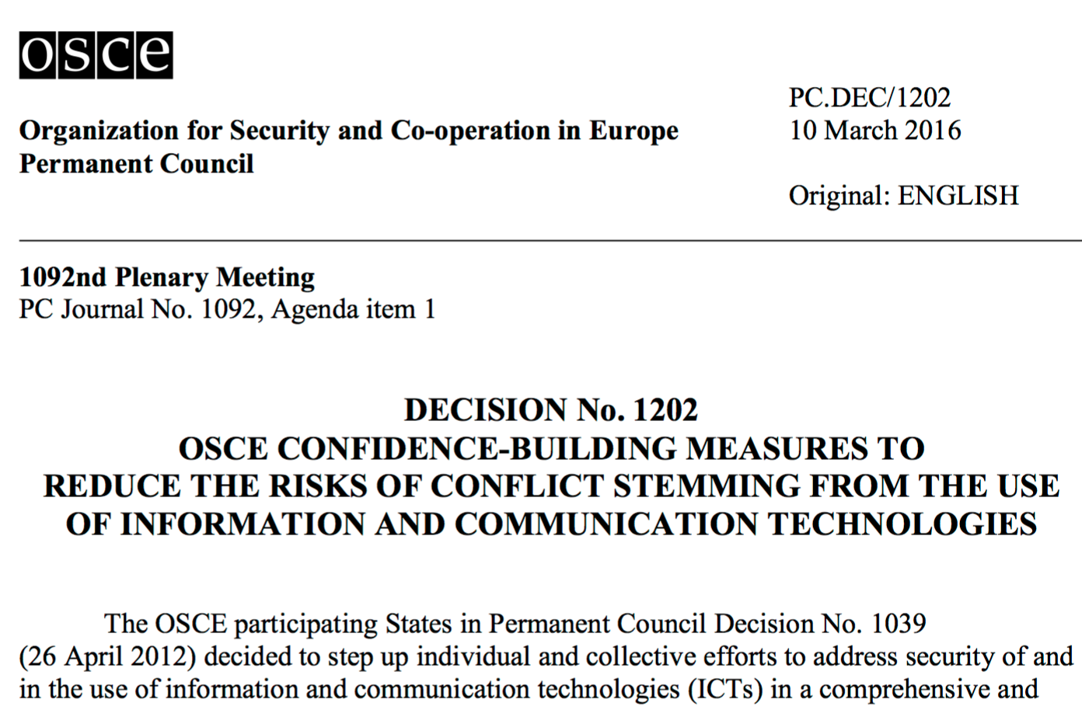

International Processes: Council of Europe, OSCE, UN GGE, London, ARF
Example CBMs
Cybersecurity and Resilient Internet
Notes:
Lybia Standby force

Slide 15
UN GGE 2010/2013/2015 Reports called for International Cooperation and Assistance in ICT Security and Capacity:
“A lack of capacity can make a State’s citizens and critical infrastructure vulnerable, or make a State an unwitting haven for malicious actors.”
“Assistance to build capacity in ICT security is also essential for international security, by improving States’ capacity for cooperation and collective action.”
“The 2013 GGE Report already called upon the international community to work together in providing assistance to improve the security of critical ICT infrastructure; develop technical skills and appropriate legislation, strategies and regulatory frameworks to fulfil their responsibilities; and bridge the divide in the security of ICTs and their use.”
“The 2015 Group also emphasized that capacity-building involves more than a transfer of knowledge and skills from developed to developing States, as all States can learn from each other about the threats they face and effective responses to them.”

Slide 16
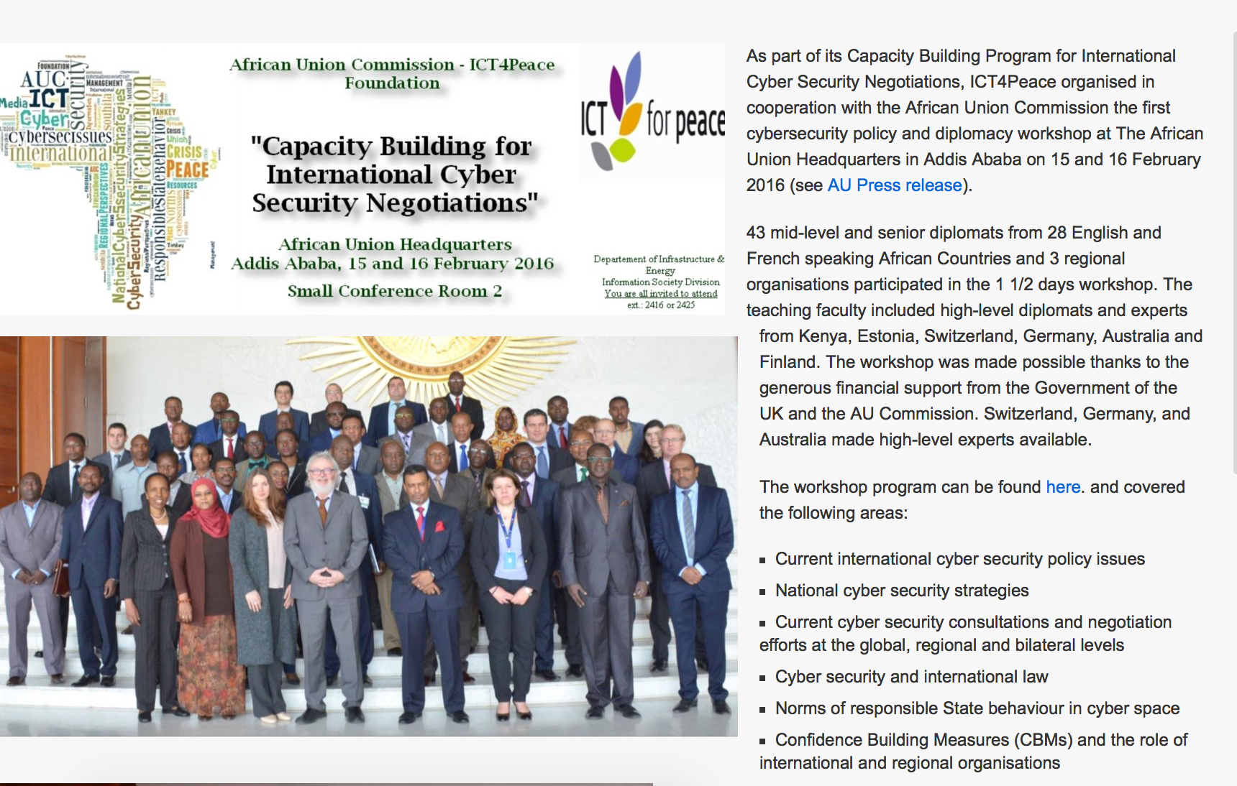
ICT4Peace Cybersecurity policy and diplomacy capacity building program with different regional organisations.

Slide 17
    ICT4Peace Regional Workshops on Cybersecurity Policy and Diplomacy (incl. at OAS, AU, ASEAN, OSCE, GCSP)
              Curriculum
Current international cyber security policy issues
Current cyber security consultations and negotiation efforts at the global, regional and bilateral levels
Cyber security and international law
Norms, rules and principles of responsible State behaviour in cyber space
Confidence Building Measures (CBMs) and the role of international and regional organizations
Regional Practice, Perspectives and Policy Options
Good Practice in National Cyber Security Strategy Building
Good Practice in National Cyber Security Legislation
Good Practice in CERT Structures and Operations including Capacity Building and Regional Cooperation

Slide 18
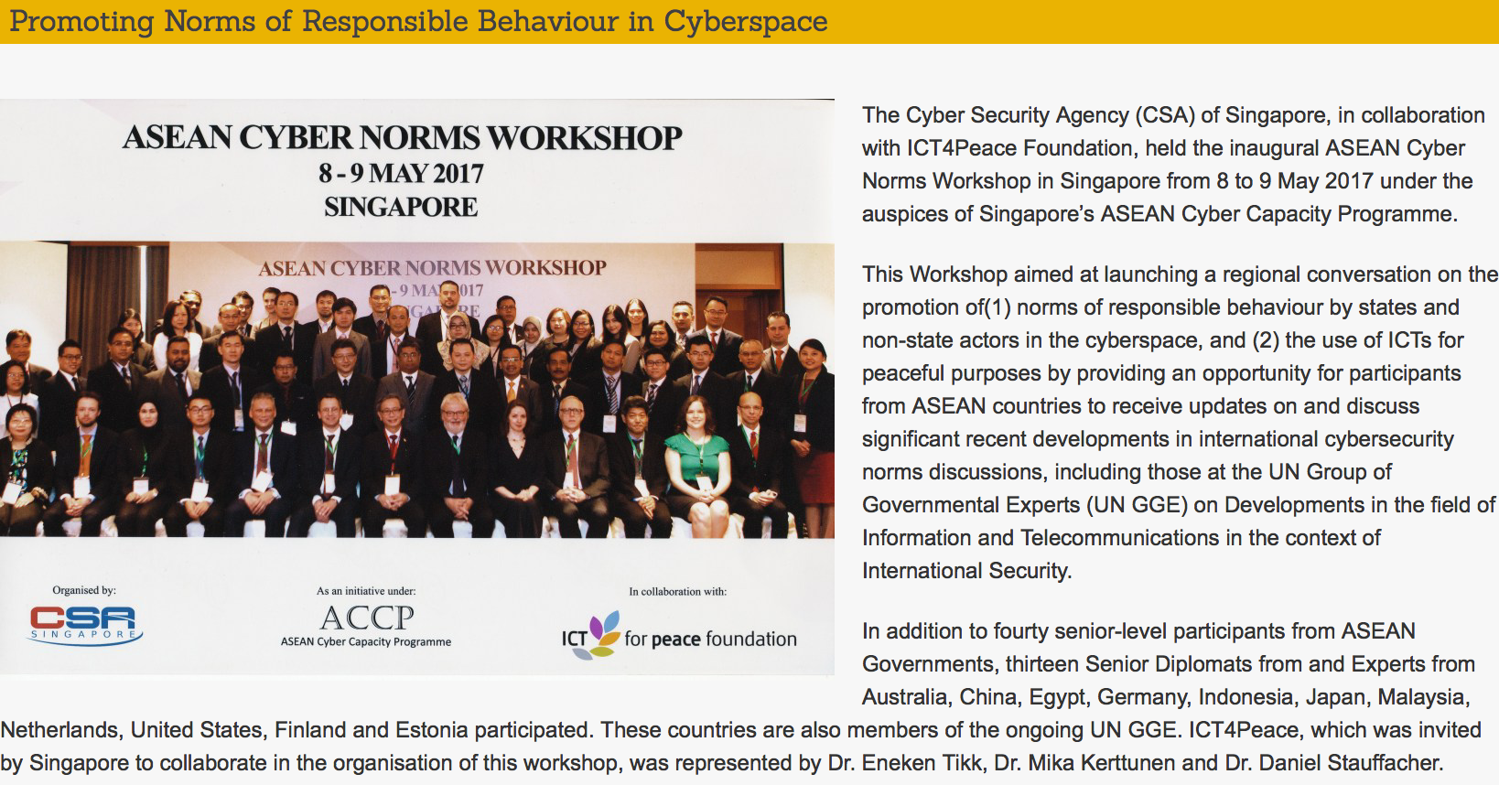
Vielen Dank – Merci Beaucoup
danielstauffacher@ict4peace.org

Slide 19
Some initial observations:
- Welcome increased interest in and offer of Cybersecurity Capacity Building projects (supply and demand).
- However, despite the welcomed coordination efforts by e.g. Global Forum for Cyber Expertise (GFCE), Oxford Global Cyber Capacity Centre (GCCC), there is a risk of loosing the overview of and duplication of efforts.
- Therefore we need an evaluation of the first generation of Cybersecurity Capacity Building Projects, more quality control and peer review of initiatives and projects, and help identify gaps.
Nature of most projects so far could be summarized as follows:
- Awareness creation for policy makers
- Maturity self-assesment tools (Capability Maturity Model)
- General discussions of global and regional cybersecurity policy issues.
- Need more resources to support hands-on training at country level e.g. for Cert development and Cert-Cert cooperation and for cybersecurity strategy building and legislation;

Slide 20
Some initial observations (continued):
- Need more training in cybersecurity policy and diplomacy topics, such as norms, rules and principles of responsible state behaviour, application of international law, Confidence Building Measures; Difficulty so far in bringing some Foreign Ministries and Diplomats to recognize importance of Cybersecurity (still considered a matter for IT Departments or security institutions);
- Need to include in curricula UN GGE references Human Rights Protection. GGE 2015:
- Need more joint trainings bringing together technical (Cert) and Policy and diplomatic personnel. They have to understand better their respective concerns and language. - Need more multi-stake holder participation in trainings, especially private sector.
- Given that accumulating, correlating, and analyzing incident-related data is taking place at the enterprise or CSIRT level, “Bottom-up” initiatives should be supported rather than policy and risk management programs on a “top-down” basis (World Bank).
- Need national ownership by national stake-holders

Slide 21

Connecting industry, government, and civil society to prevent
the terrorist use of the internet whilst respecting human rights
techagainstterrorism.org @techvsterrorism
A joint project implemented by UN CTED and ICT4Peace Foundation
under mandate of the United Nations Security Council Counter-Terrorism Committee

Slide 22





In this project we are focusing on tech organisations that can be exploited by terrorists to publicise, recruit, and support operations
1
2
Publicity and recruitment
Operational usage (overt / covert)
Social media and sharing platforms
Communications and messaging
Content storage and knowledge sharing
Financial funding and transfers

Slide 23

Large tech companies have developed an “emerging normative framework” to help tackle the terrorist use of tech
1
2
3
Terms of Service & Respect for Rights
Content Takedowns
Transparency Reports
Community guidelines and standards respecting freedom of expression and human rights principles
Operational definitions of violent extremism and terrorism
Content reporting by users, NGOs, and governments
Engagement with law enforcement
Engagement with Internet Referral Units (IRUs)
Careful deliberation of what content / accounts to take down given ToS
Regular reports of government and user-generated take-down requests
Transparency around government requests as protection against censorship concerns

Slide 24









Startups, however, often lack the capacity to set up effective defences and respond quickly to terrorist exploitation
We aim to provide support…
1
Inform the debate
and understand requirements
Promote the project
Engage startups
Organise workshops
Create guide / startup primer Risks / Challenges
2
Provide operational advice and know-how in the short term
Case studies and networking
Data Science Network
Operational advice
ToS
advice
3
Build online tools to help in the long term
Assessment tools
ToS Creator & Pledge
Trustmark
Standardised reporting formats

Slide 25
Thank You - Vielen Dank
Merci Beaucoup
danielstauffacher@ict4peace.org

