Slide 1
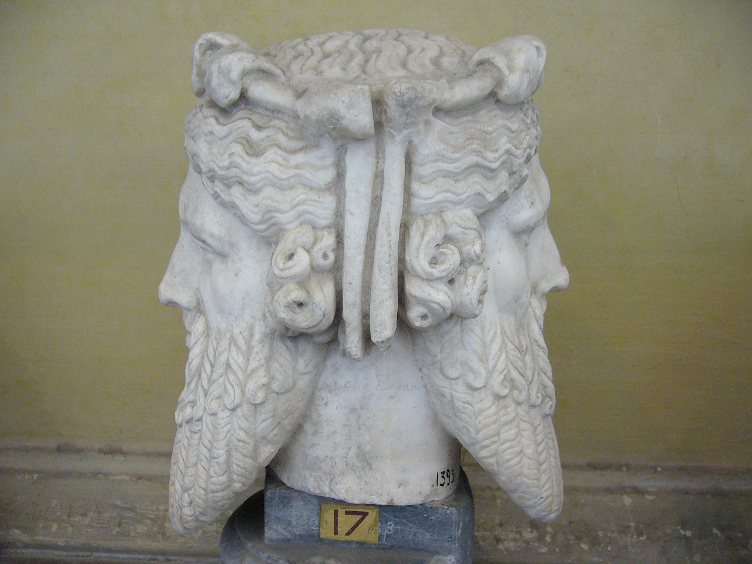
The Janus Effect: Social Media in Peace Mediation
Sanjana Hattotuwa
ICT4Peace Foundation

Slide 4
How will radical transparency & pervasive technology impact closed door, high-level negotiations? What is the future of Chatham House Rule?

Slide 5
How will millions of lifestreams, freely accessibly on the web, impact in real time negotiations around identity & resources? How will lifestreams from negotiations impact fragile societies?

Slide 6
justice & reconciliation
Beyond lib-dem, Judeo-Christian frameworks. What will it mean for digital natives & entrenchment of outcomes?

Slide 7
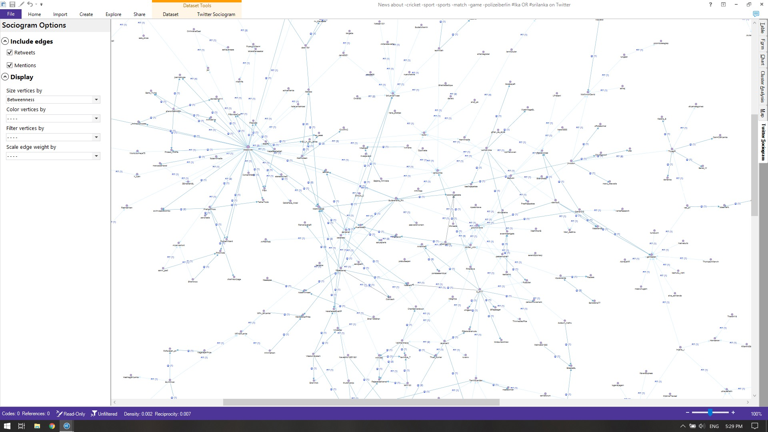
big data for context
Beyond the event driven, underlying drivers of peace & violent conflict

Slide 8
Signal vs. noise
How do recognise what’s important?

Slide 9
Weaponisation of social media
You cannot embrace the positive without planning for the negative

Slide 10
Thank you

